Slide 1







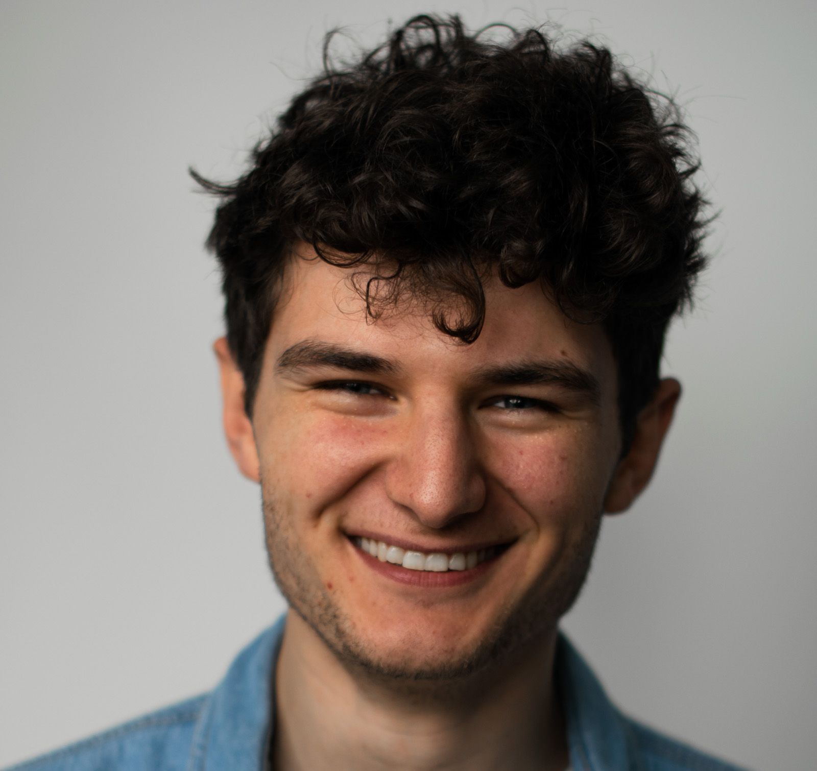
EVENT REGISTRATION LINK
Global WiLAT
Webinar Series
Green Logistics & Carbon Emission
Date: 16th December, 2021 5-6.30pm HK/SIN/MAL Time (GMT+8)
PANEL SPEAKERS
Moderator
Nancy Qian
Incoming GVC East Asia
Dr Mayuri Wijayasundara
Strategy & Transformation Expert, Circular Economy
Francesco Zhang
Solution Consultant
CHEP China
Noah Schaul
Business Development Manager
InChainge B.V

