Slide 1
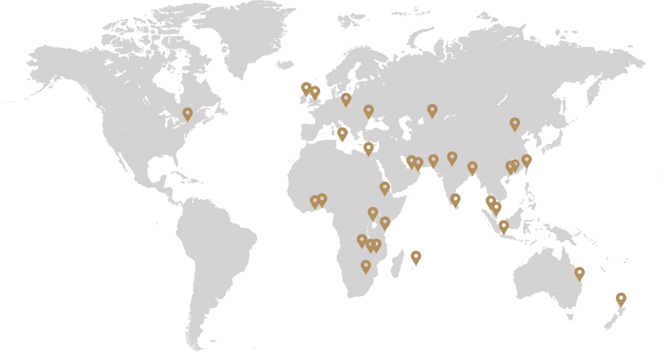
Response coverage from our global training family
Countries with training providers that replied to our Covid-19 impact survey

