Slide 1
The Global Logistics Game
Rules of the Contest
This game is for a team of three to six logistics students, currently studying in either a technical college or a university across any CILT country.
The team is to attempt to distribute a manufactured, and an agricultural product, produced in three countries across four continents over a simulated period of a year. The distribution will cover four transport modes also allowing interconnection between modes at certain hubs. On occassions there will be events that occur that may change the dynamics of your goods, its shipping or its destination. Look out for these News Bulletins.
Each continent will be serviced by four modal operators, production and demand will be generated and currency exchange and fuel prices will change monthly.
The aim of the challenge is to distribute to a set service level by product, using the modes available and balancing on time demand and cost of distribution.
Sponsors may be sourced for each mode for the air, sea, rail and road modes by continent for a negotiated period. This revenue will cover the developmental IT costs and the prizes for the successful teams.
This game will put the CILT family in a class of its own!!!!
Rules of the Competition:
Each Student may be given a business challenge to solve in order to progress to the next level. There are 5 levels to be achieved within each challenge. Each completed level will issue a score for the Student Team out of ( /10) ten. As a score (pass) is achieved they go onto a student board where their name and country will feature. They will see how their score compares to competing countries and how many levels have been completed by all Student Teams who are entered in the competition.
There is a leader board for all to view.
The competition involves simulated travel and research will be required before attempting each task within a set for each country challenge.

Slide 2
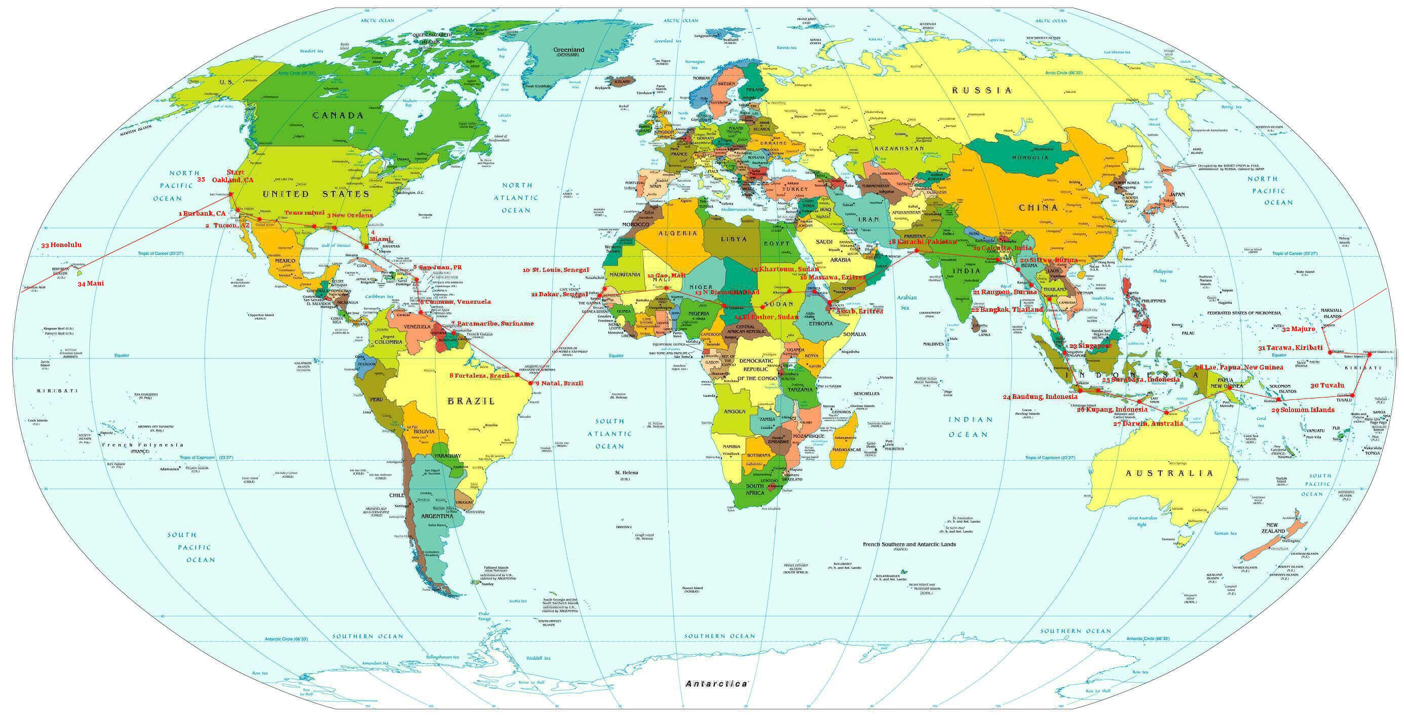
The Global Logistics Game
Australia’s Great Idea

