Slide 1
«CILT Kazakh-China International Conference on the Development of Logistics and Transport Infrastructure» at ICBC "KHORGOS"

Slide 2
Goals and objectives of the conference
To promote the development of research and innovation activities in the field of logistics and transport infrastructure in the framework of One Belt and One Road and Nurly Zhol programs.
Expected contingent of participants:
Members and non-members of CILT, Transport and logistics companies, Educational institutions, Government Officials.
About 150 people

Slide 3
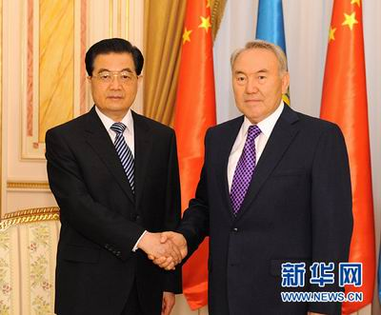
PROPOSED VENUE OF THE CONFERENCE
The Khorgos International Centre оf Boundary Cooperation
The history of the creation of the International Center for Cross-Border Cooperation "Khorgos" was laid in the framework of the state visit of President of Kazakhstan Nursultan Nazarbayev to China on December 22-25, 2002
ICBC "Khorgos" consists of Kazakh and Chinese parts, located on the border of neighboring territories of the two countries with a total area of 560 hectares and connected by "special passage" taking place across the state border.
Citizens of the Republic of Kazakhstan, China People’s Republic and other countries can stay within the area of “Khorgos” International Centre of Border Cooperation both at its Kazakhstan and at China part without the need for any visa for the period of up to 30 days based on the valid documents agreed and acknowledged by the competent authorities of the countries involved.
“Khorgos” ICBC consists of the two parts: Kazakhstan part – located in the territory of Panfilovskiy raiyon of Almatinskaya oblast, and China part – located in the territory of the Ili-Kazakh Autonomous Prefecture of Xinjiang–Uyghur Autonomous Region.

Slide 4
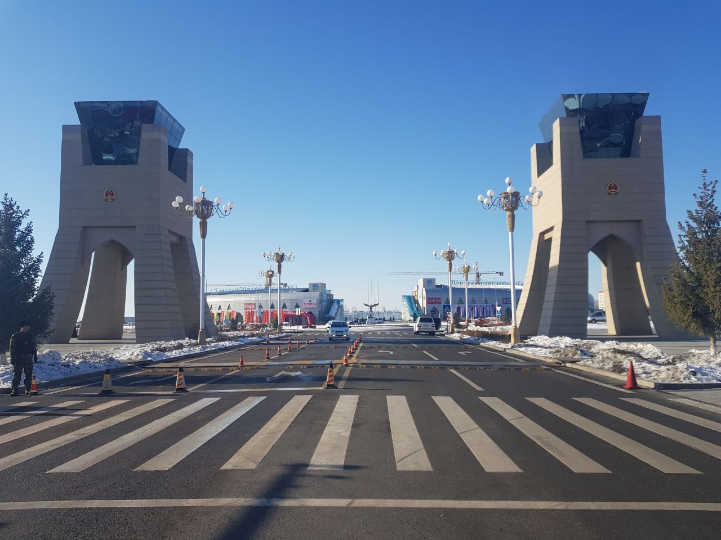
THE KHORGOS INTERNATIONAL CENTRE OF BOUNDARY COOPERATION
The distance from the Kazakhstan part of “Khorgos” ICBC part to the regional center of Almatinskaya oblast – Taldykorgan city, is 321 km., and 361 km. to the largest city of the Republic of Kazakhstan – city of Almaty.
“Khorgos” ICBC is located 1 km. away from the China’s border city Khorgos, 90 km. away from the nearest major city of Ili-Kazakh Autonomous Prefecture – Yining, and 670 km. from the administrative capital of Xinjiang–Uyghur Autonomous Region – Urumqi.
Total area covered by the “Khorgos” International Centre of Border Cooperation is 560 hectares of which 217 hectares belongs to Kazakhstan, and 343 hectares – to China. The communication between two parts is through the special pedestrian and transportation corridor.
http://mcps-khorgos.kz

Slide 5
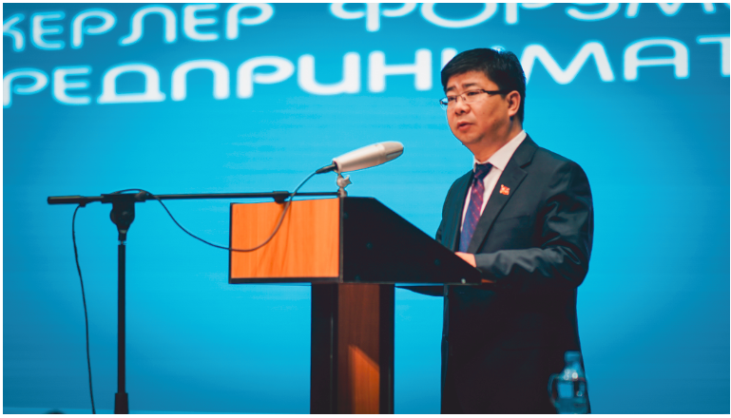
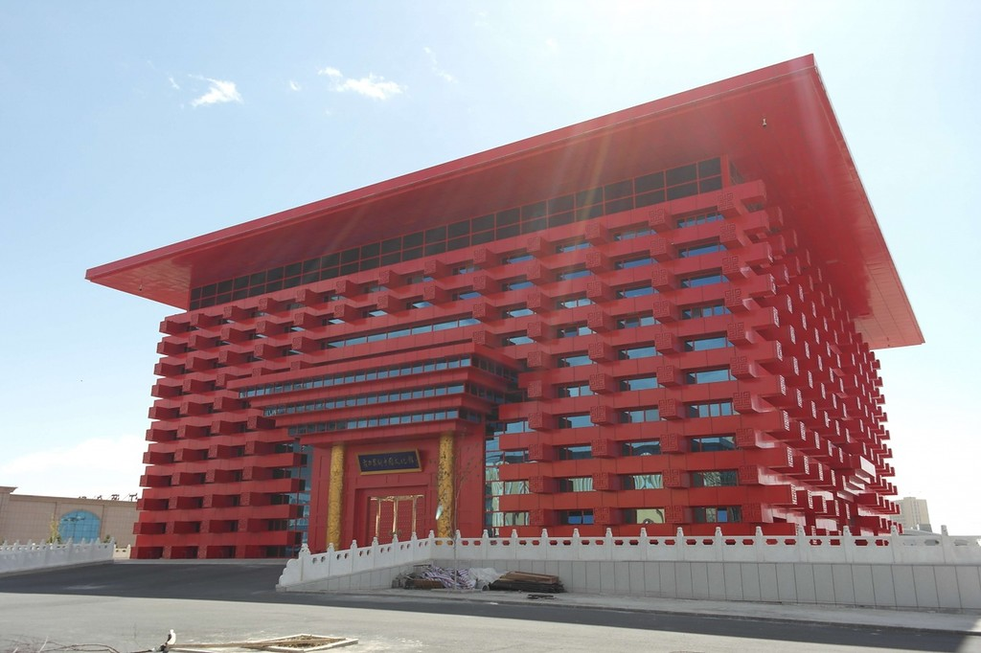
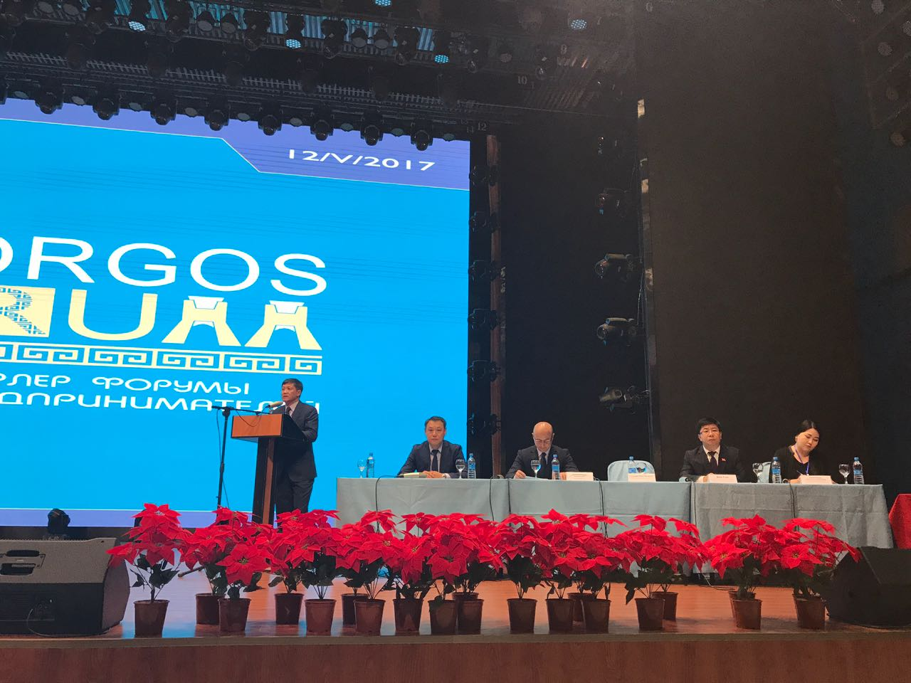
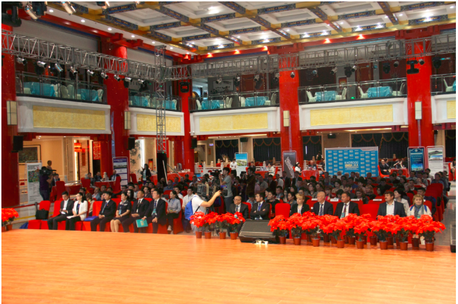
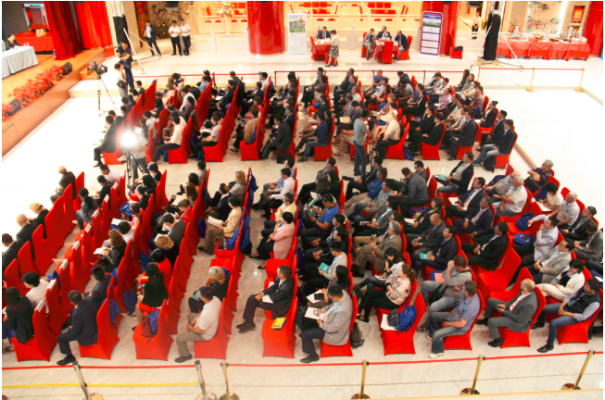
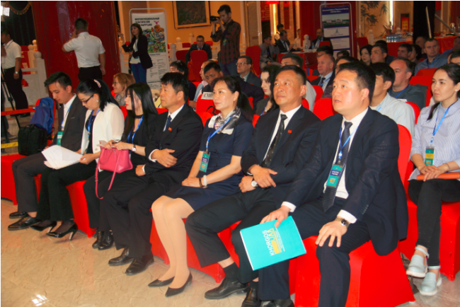
PROPOSED VENUE OF THE CONFERENCE
We propose to hold a conference on the Chinese side of the ICBC in this building

Slide 6
PROPOSED CONFERENCE PROGRAM
 | International Conference
08:00-8:30 | Registration
09:00 | Opening Ceremony
09:00-09:10 | Welcome Speech by CILT International
09:10-09:20 | Welcome Speech by ICBC “Khorgos” China
09:20-09:30 | Welcome Speech by ICBC “Khorgos” Kazakhstan
09:30-09:40 | The Development of Logistics and Transport Infrastructure and Belt and Road by Prof De-Rong Wang, Executive Vice-Chairman, CCTA
09:40-09:50 | Role of Kazakhstan in the Development of Logistics and Transport Infrastructure, by Kazakhstan Railways
09:50-10:00 | Presentation by (candidate from CILT International)
10:00-10:10 | Presentation by (candidate from CILT China)
10:10-10:20 | Presentation by (candidate from CILT China)
10:20-10:30 | Presentation by (candidate from CILT Kazakhstan)
10:30-10:40 | Presentation by (candidate from CILT Kazakhstan)
10:40-11:10 | Summary and Feedback Session
11:10-11:20 | CILT Kazakhstan's membership launching ceremony
11:20-11:30 | Closing Remarks by CILT International
11:30-11:40 | Group photo
12:00-13:30 | Lunch
13:30-16:00 | Technical tour
- | The proposed tour inside ICBC "Khorgos" (Who to those who doesn't have Kazakh visa)
- | The proposed Technical tour to Kazakhstan side (Railway station, dry port, SEZ Khorgos Eastern Gate)

Slide 7
«CILT Kazakh-China International Conference on the Development of Logistics and Transport Infrastructure» at ICBC "KHORGOS"
№ п/п | Activities | Form of completion | Fulfillment of deadlines | Responsible for execution
1 | Conducting the Conference Call with CILT (UK, China, KAZ) on the organization of an international conference in September 2018. | Preliminary plan | May 2018 | CILT (UK,China,KAZ)
2 | Determining the number of participants, a list of the organization, a list of speakers, etc. | List | May 2018 | CILT (UK,China,KAZ)
3 | Determining the cost of renting a conference hall on the territory of ICBC "Khorgos", the cost of food, accommodations. | Commercial offer | May2018 | CILT Kaz
4 | Determining the scheme of travel from Almaty and Urumqi, the cost of transportation costs, modes of transportation and etc. | Transportation plan | May 2018 | CILT Kaz, KazATC
5 | Approval of the conference program (exact dates, the list of participants, the cost, the transportation plan and etc.) | Approved program | May 2018 | CILT (UK,China,KAZ)
6 | Seeking funding for an international conference in September 2018 (review of its own funds, registration fees, sponsorship). | Fund | May - June 2018 | KTZE, KazATC, CILT (UK,China,KAZ)
7 | Booking conference room, vehicles, food and etc. | Contract | May 2018 | CILT Kaz
8 | Invitation sending (to the companies, government structures, universities, associations and media) | Invitations | May 2018 | KazATC, CILT (UK,China,KAZ)
9 | Creating a group of volunteers for the organization (with knowledge of English and Chinese) | List of volunteers | July-August 2018 | KazATC, CILT Kaz
10 | Confirmations of participants | Official confirmation | July-August 2018 | KazATC, CILT (UK,China,KAZ)
11 | Departure of the working group in ICBC "Khorgos" | - | September 2018 | KazATC, CILT (UK,China,KAZ)
12 | Conducting the Conference | - | September 2018 | KTZE, ICBC, KazATC, CILT (UK,China,KAZ)

Slide 8
Thank you

