Slide 1
Why You Should Tweet
Ceri Williams, International Communications Co-ordinator
Jasper Cook, Digital Communications Consultant

Slide 2
A Digital Institute

Slide 3
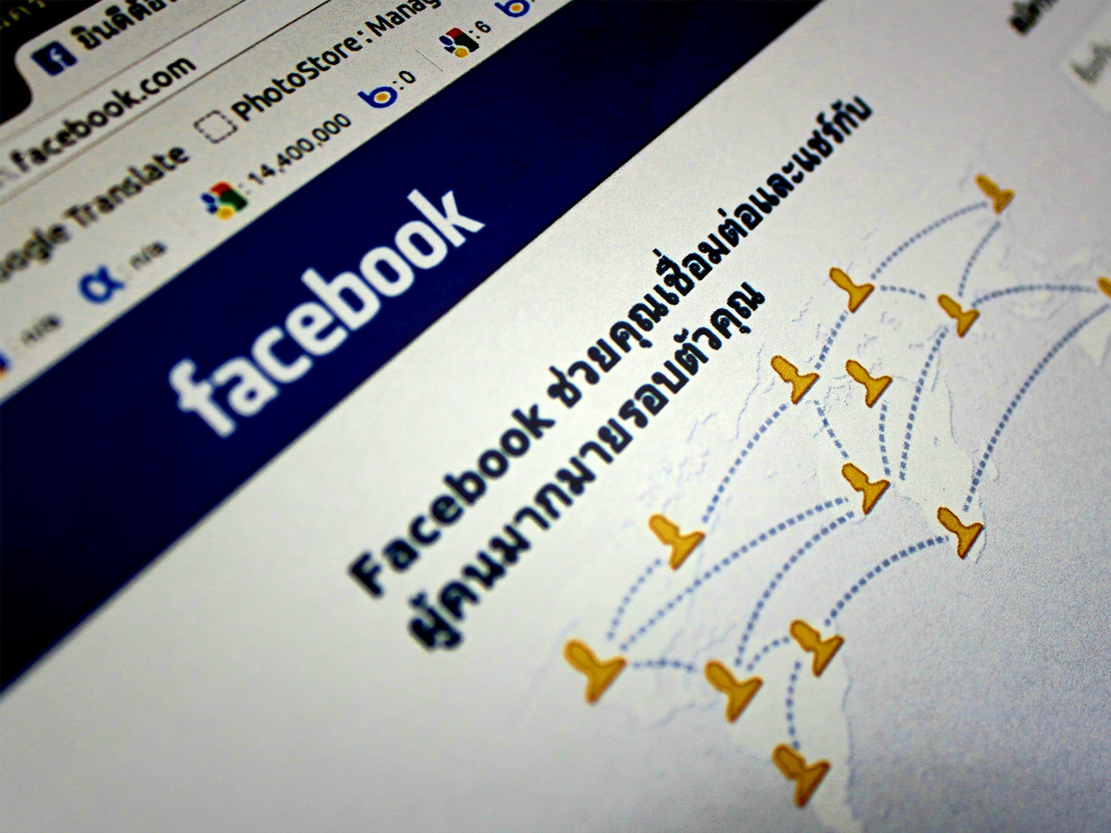
A Digital Age calls for a Digital Institute
3.77 billion global internet users in 2017, equaling 50% of global population.
2.80 billion global social media users in 2017, equaling 37% of global population.
4.92 billion global mobile users in 2017, equaling 66% of global population.
2.56 billion global mobile social media users in 2017, equaling 34% of global population.
Source: https://wearesocial.com/uk/special-reports/digital-in-2017-global-overview
3 International Convention 2018 Wroclaw | Poland Linking CEE and the World | Impact of the Electric Car Revolution
www.ciltinternational.org

Slide 4
It’s Good For The Institute
We gain a global platform to tell our story, share brand and membership stories, and increase our brand visibility.
We can communicate to a wider, outward-facing global audience, not just those people visiting our websites or receiving emails from us.
We can increase traffic to our international and branch websites, improve search (SEO) rankings, and gain traction for our messages, content and services.
We can build relationships with existing members, and initiate dialogue with prospective members.
We can utilise the strength of our membership to reach out more cost effectively than through traditional paid media.
We can have direct conversation with our audience, and gain better insights into them and the things that interest them.
We can improve engagement within our branches and open channels of communication.

Slide 5
A Digital Institute Has…
Increased educational offering take up.
Increased membership.
Increased member engagement.
Greater brand awareness.
Interconnected members, helping to realise our goal of being Stronger Together.

Slide 6
It’s Good For Members
It will help members make connections and create effective professional networks.
It will allow individuals to build their profile and reputation through sharing content and opinion.
It will give them the access they expect to the resources they need.
It will allow members to gain industry recognition of their relationship with the Institute.

Slide 7
It’s Expected Of Us
As leaders of our profession we should be ahead of the curve, not behind it.
Young Professionals are a target area for growth and expect the Institute to have a strong online presence.
Networking is a benefit we offer members and this is how the modern professional networks.
We need to be relevant and accessible to current and future members.

Slide 8
It’s Here To Stay

Slide 9
Impact of
Social Media

Slide 10
Facebook Impact
1,547 followers since the account was opened
17,480 people reached since last year
2,832 page views since last year
8.5 actions taken per month
4.5 star rating from 18 people’s reviews
253 average post engagement per month
10 International Convention 2018 Wroclaw | Poland Linking CEE and the World | Impact of the Electric Car Revolution
www.ciltinternational.org
Notes:
Without CILT International ‘doing’ social media these extra stats and visitors would not be visible and may have never found the website?

Slide 11
Twitter Impact
1,200 followers since the account was opened
22.5k impressions over the last 90 day period
281 impressions per day over the last 90 day period
61 Retweets over the last 90 day period
90 new likes over the last 90 day period
89 clicked links over the last 90 day period
11 International Convention 2018 Wroclaw | Poland Linking CEE and the World | Impact of the Electric Car Revolution
www.ciltinternational.org

Slide 12
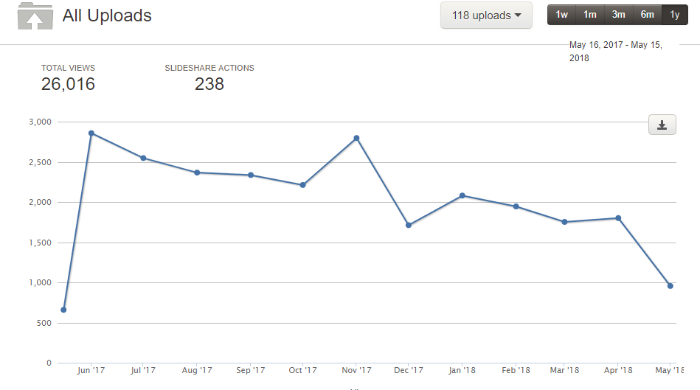
SlideShare Impact
Notes:
Assume the peaks are after events like the China Conference and the Annual Convention

Slide 13
LinkedIn Impact
8,887 follower since the account opened
72 employees linked / listed as working for CILT
89 clicked links over the last since January 2018
29,332 impressions since January 2018
305 clicks on posts since January 2018
112 social actions – sharing / li since January 2018
13 International Convention 2018 Wroclaw | Poland Linking CEE and the World | Impact of the Electric Car Revolution
www.ciltinternational.org

Slide 14
Website Impact
78.3% increase in new Facebook visitors since last year
16.5% increase in new Twitter visitors since last year
66.7% increase in new LinkedIn visitors since last year
02:08 mins / secs spent on the website with an average of 3 page views
06:04 mins / secs spent on the website with an average of 3.5 page views
01:43 mins / secs spent on the website with an average of 2 page views
14 International Convention 2018 Wroclaw | Poland Linking CEE and the World | Impact of the Electric Car Revolution
www.ciltinternational.org

Slide 15
Impact Of Increased Activity

Slide 16
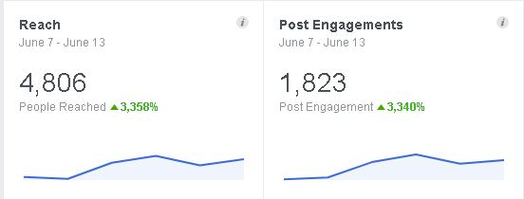
Facebook

Slide 17
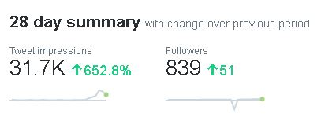
Twitter

Slide 18
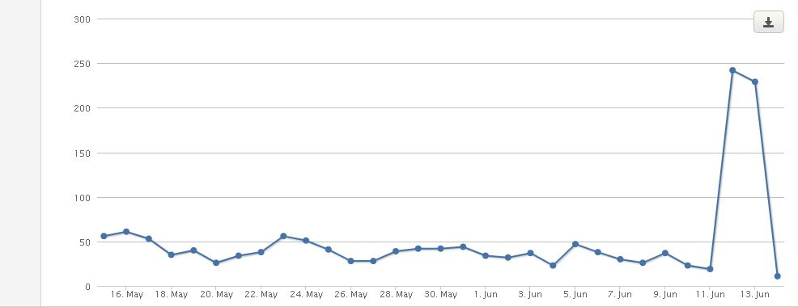
SlideShare

Slide 19
Audience Insights

Slide 20
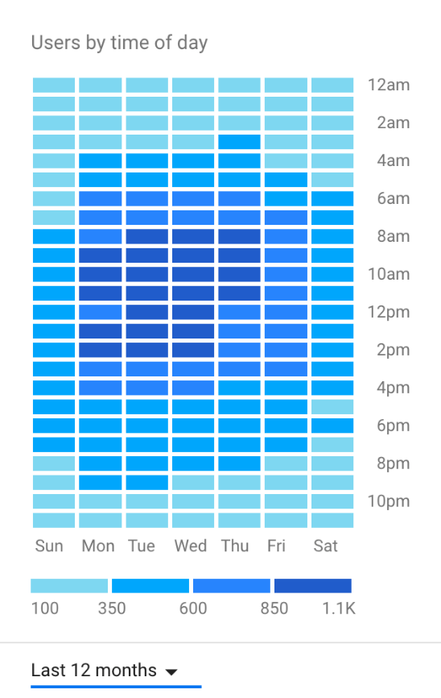
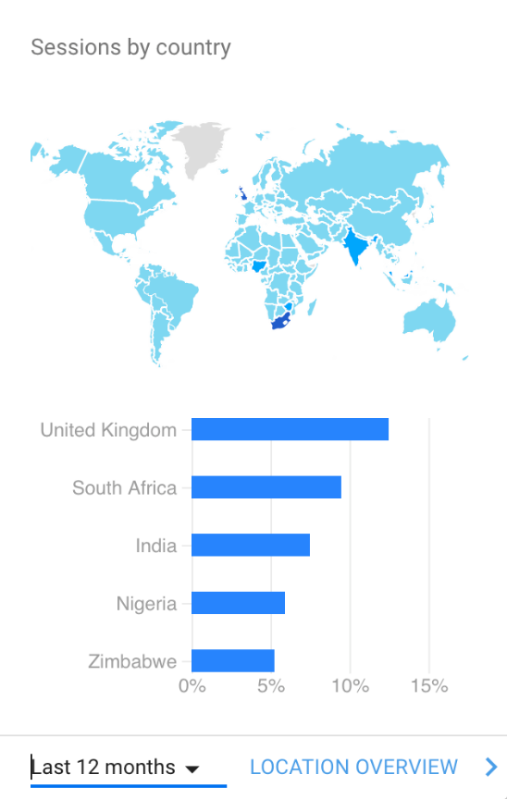
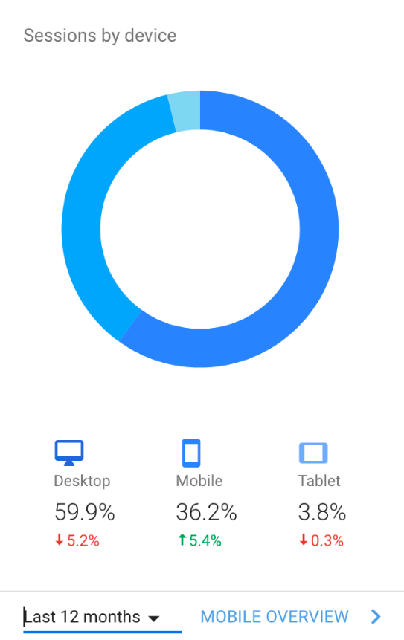
Website

Slide 21
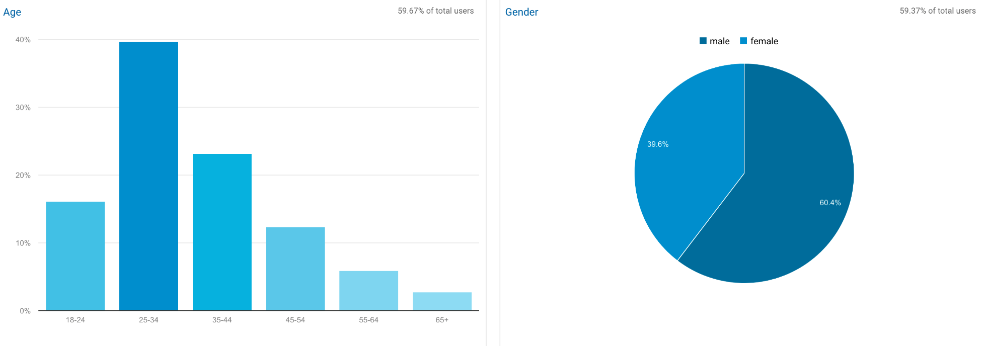

Slide 22
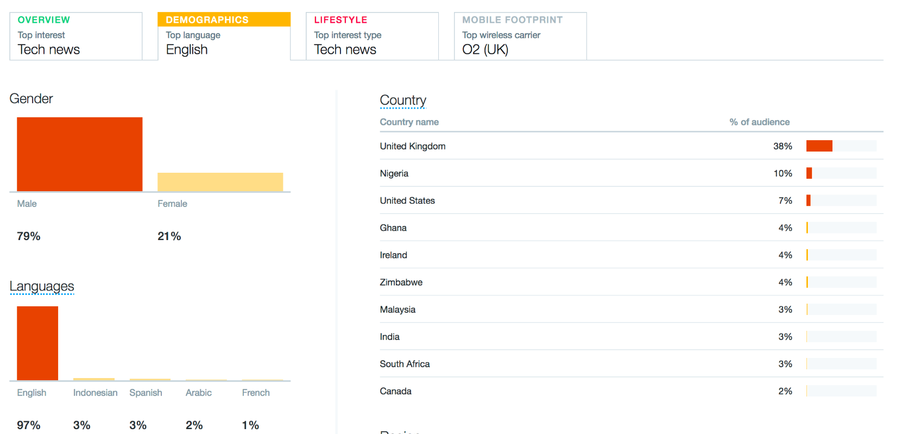
Twitter

Slide 23
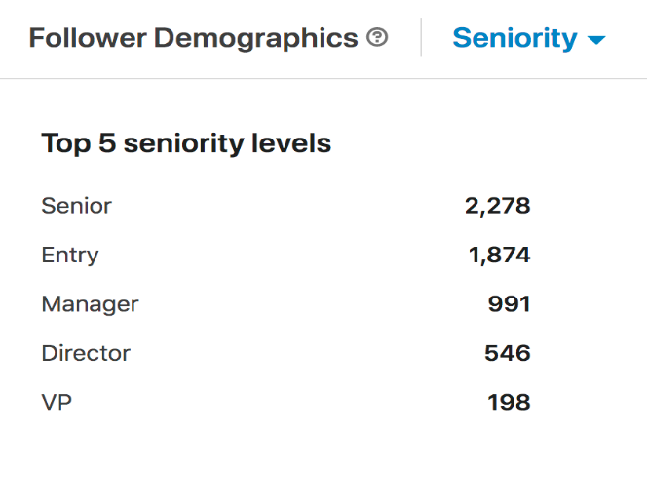
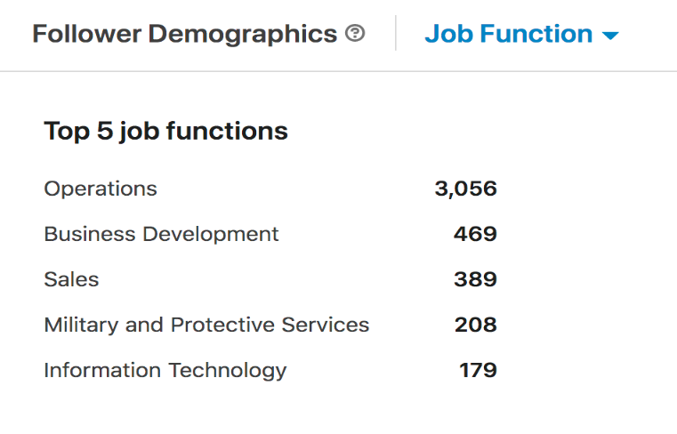
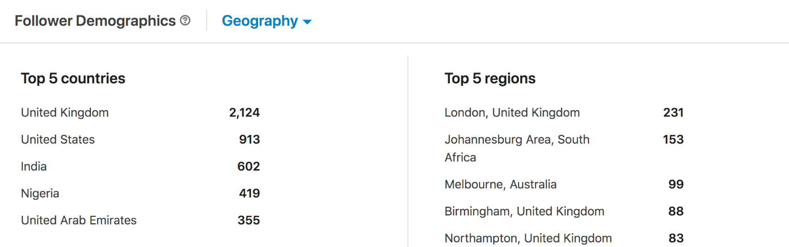
LinkedIn

Slide 24
Facebook

Slide 25
Getting
Started

Slide 26
Getting Started
Set up your account
Create your profile page
Connect
Join the conversation

Slide 27
Getting Started
Set up your account
Create your profile page
Connect
Join the conversation

Slide 28
Getting Started
Set up your account
Create your profile page
Connect
With International
With Branches
Other Members
Industry Influencers
Industry Media and Organisations
Join the conversation

Slide 29
Getting Started
Set up your account
Create your profile page
Connect
Join the conversation
Comment
Post News and Respond to Events
Offer Opinions
Quote
Share Papers and Presentations

Slide 30
Best Practice

Slide 31
Best Practice
Be quick and nimble. You have 24/48 hours to respond to external trends and stories to be picked up.
Listening. Don’t just broadcast, listen to conversations, understand what is out there and get involved.
#hashtags. Use informative or popular hashtags to help syndicate your posts to wider audiences, the top tweets are a great example of this in action.
Quote credible sources. Ensure the content you link to is credible.

Slide 32
Best Practice
People Love Pictures. It’s proven that links with images or video content get better interactions.
Quote. Use statistics, quotes, retweets and opinions to generate interest and create a context for your comments.
Handles and Usernames. Linking to people you know or who are interested in the topic you’re discussing helps you reach out to a wider audience.
Sharing Papers and Presentations. Add to the debate and define your opinions in the public sphere.

Slide 33
Best Practice
Link To The Institute. Help drive traffic to our websites, and introduce our brand to the debates of the day.
Be Friendly. The Internet is fairly informal, and your choice of tone should reflect that. Some areas such as LinkedIn are more oriented to professionals and here a more formal tone is appropriate.
Posting frequency. Posting regular content is good, however do not post for the sake of posting. On twitter posting more regularly is fine, as is repeating a message at different times of the day to reach as wide an audience as possible.

Slide 34
Top
Posts

Slide 35
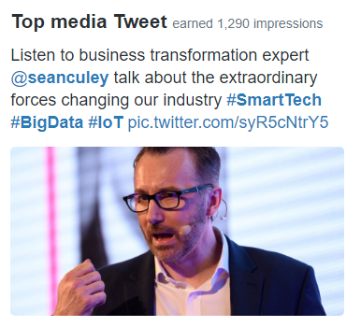
Top Posts
Twitter

Slide 36
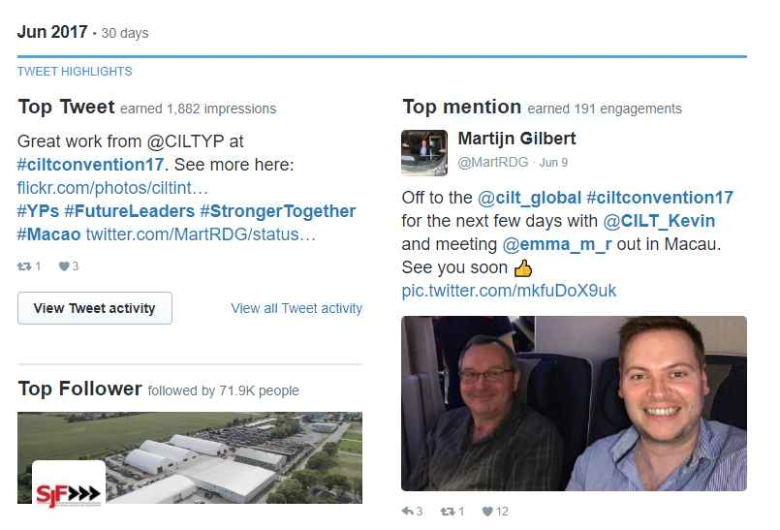

Slide 37
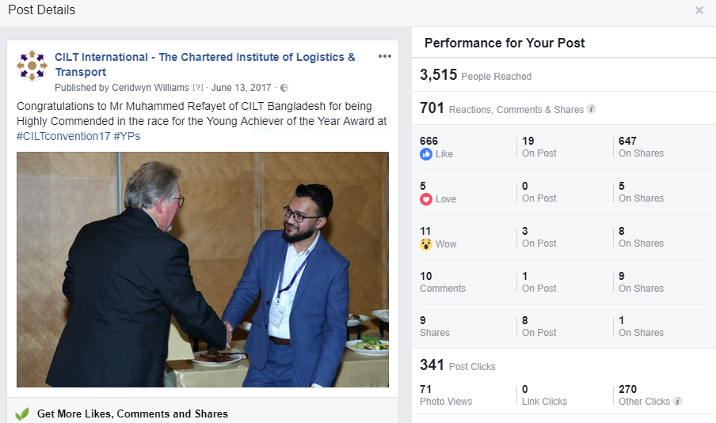

Slide 38
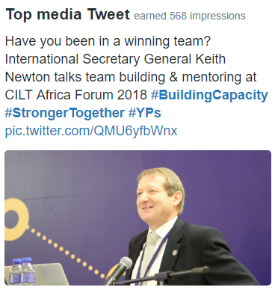
Keith Goes Viral @ Africa Forum 2018

Slide 39
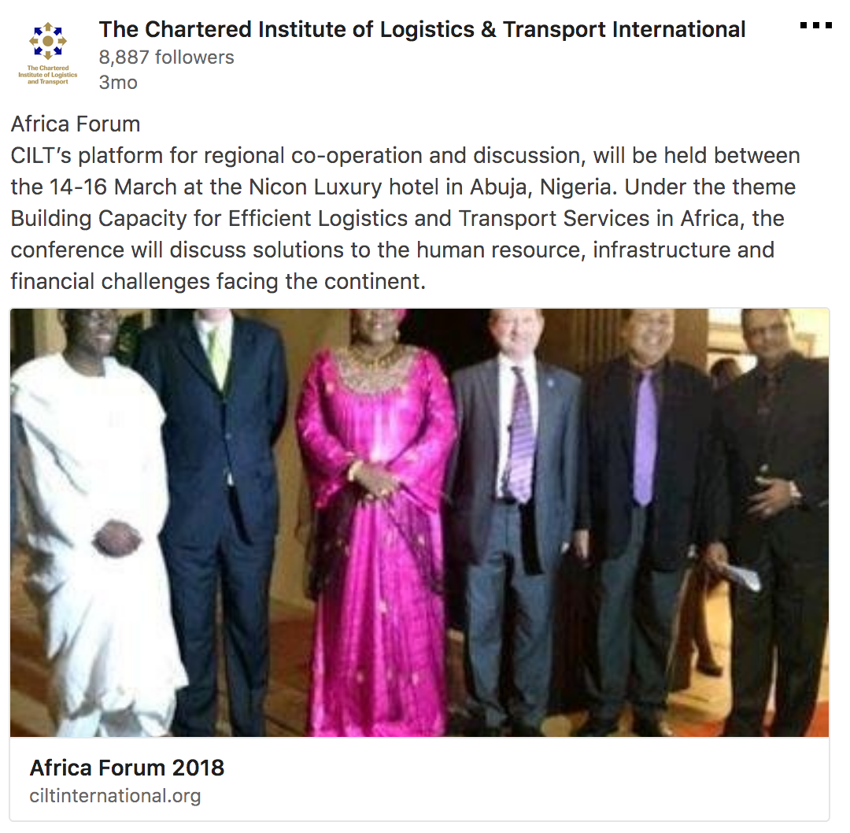
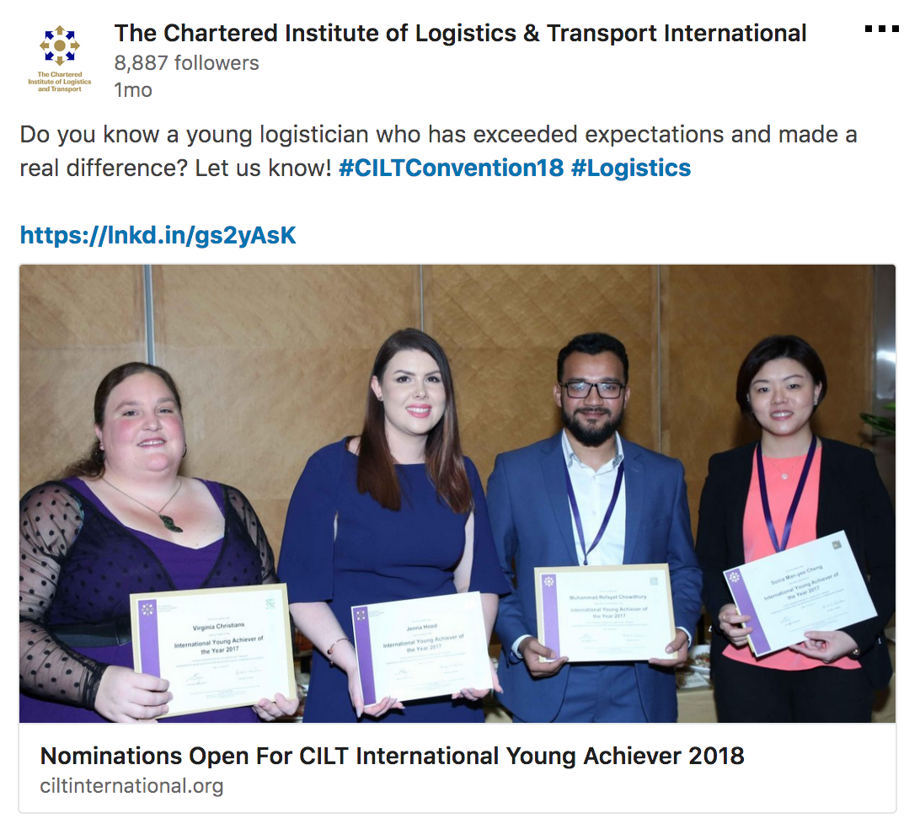
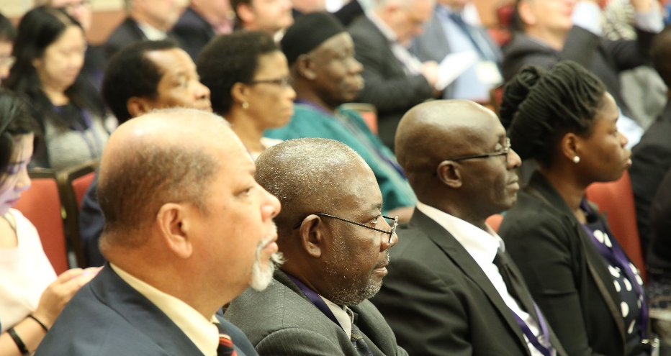
Top impressions: 6,473

Slide 40
