Slide 1
CILT Introduction Background to setting up a branch
Keith Newton
International Secretary General
The Chartered Institute of Logistics and Transport

Slide 2
We are CILT
We are the leading professional body for everyone who works in supply chain, logistics and transport.
We are a global family, representing professionals at all levels across all sectors, with a mission to give individuals and organisations access to the tools, the knowledge and the connections vital to success in the logistics and transport industry.

Slide 3
We are CILT
Our Institute was founded in 1919 with a mission to improve industry practices and nurture talent.
Today we support over 35,000 members in 35 countries.
Through our educational suite, our strong community and our commitment to high standards, we help professionals to develop their careers and access better jobs.

Slide 4
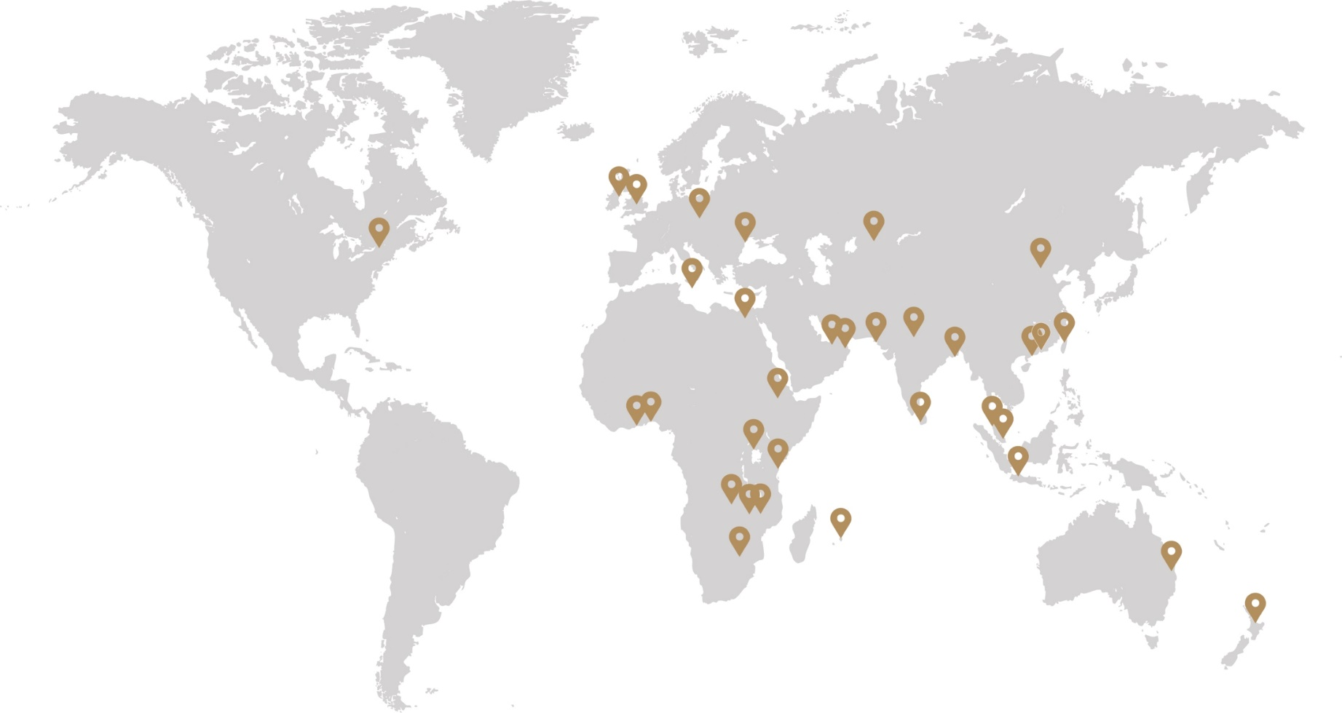
At Convention 2018 we welcomed our 35th branch CILT Poland

Slide 5
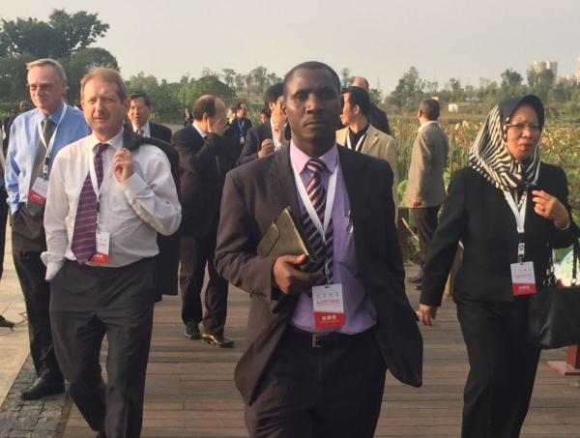
Working together across continents we are Stronger Together!

Slide 7
Council of Trustees
International Management Committee
International Audit Committee
Women in Logistics & Transport
International Membership Standards Committee
International Young Professionals Committee
Accredited Education Providers
Territories and Branches
Members
International Council
International Education Standards Committee

Slide 8
International Council
Finance & Legal
CILT UK
Education
CILT UK
Marketing
CILT International
International
Secretariat
Membership
CILT Hong Kong

Slide 9
International Secretariat
Keith Newton – Secretary General
Jon Harris – Education Strategy & Business Development Manager
Ceri Williams – Marketing, Governance & Communications Manager
Zoe Roberts – Education Services Manager
Jasper Cook – Communications Coordinator
Claire Weldon – Administrative Assistant

Slide 10
Responsibilities
Keith – Strategy, overall governance of CILT, working with key committees, relationship management with Branches & Territorial Organisations, Education Business Development & Partner Management. Reports to Trustees
Jon – Education and Professional Development Strategy, IESC lead, accreditation of training providers, quality control, process improvement, resource development. Reports to Keith.
Ceri – Marketing & Communications leadership & management. Detailed management of brand, membership and country reporting standards and actions. Provision of Committee management and communications, website updates, event, contact listings etc. Event Management lead. Reports to Keith.

Slide 11
Zoe – Education Process& Finance Management & Administration, Student & Education Training partners liaison, credit control. Education meetings, education communications & management. Reports to Keith & Jon.
Jasper – Web & PR, social media & communications lead. Reports to Ceri.
Claire – Administrative support for all country governance & reporting, committee structures & meetings & events. Reports to Ceri.

Slide 12
International structure & setting up a CILT branch
CILT has 35 different countries set up as branches or territories globally
We encourage the establishment of a CILT branch in a new country or region
A Branch sits within an International Structure as defined by the Bye-laws (document available to review). A Territory is an established branch with greater delegated powers
Each branch is established by the signing of a Delegation Agreement
CILT International supports the establishment of a new branch with its “Branch in a Box” toolbox
Each Branch needs to establish a local governance structure that is centred on a executive committee or management board made up of local members with clear accountabilities

Slide 13
International structure & setting up a CILT branch
As a minimum the Branch should elect a chairman and treasurer from the committee and consider other committee posts.
These posts should be appointed for a period and elected as a minimum once every 4 years
A Branch should establish financial structures and a branch bank account to manage appropriately branch financial transactions
There should be provision for administrative support locally for the Branch to properly administer membership & education activities
Once established a branch pays annual fees to CILT International once a year based on membership numbers and revenue

Slide 14
New Branch Model
Management Committee
Membership
Committee
Education
Committee
Finance
Committee

Slide 15
Established Branch
Management Committee
Membership
Committee
Education
Committee
Finance
Committee
Young Professionals
Women in Logistics & Transport
Events
Regional Centres
Marketing Communications

Slide 16
Example of Council roles
Education
Secretary
Chairperson
Deputy Chairperson
Treasurer
Membership
Supply Chain
Transport Planning
Rail
Active Travel & Planning
Bus & Coach
Ports Maritime Waterways
Freight Forwarding
Aviation

Slide 18
Membership Requirements
Administration of local membership – retaining a list of members, collection of membership fees annually, membership services locally – all needs to be done within the branch
Applications for membership need to be made locally but administered through the Hong Kong CILT who are responsible for ensuring membership standards are consistent across all branches
Membership grades should follow the standard CILT grades and proportionally follow the guidance percentages on the following slide

Slide 19
Membership Model
Grade | Members | Fee Index
Chartered Fellow | 5% | 150
Chartered Member | 25% | 125
Professional Member | 30% | 100
Affiliate | 15% | 50
Student | 15% | 25

Slide 20
Mapping out your steps to progress as a Professional: our Key Knowledge areas
Chartered Fellow – FCILT
Expertise
Chartered Member – CMILT
Competence
Climbing the ‘Knowledge Steps’ Applying Key Knowledge Areas to Professional Membership
Member – MILT
Knowledge
Affiliate and Student Members
Awareness

Slide 22
Education Requirements
The responsibility for ensuring the CILT Education standards are met lie with the International Secretariat. This responsibility is carried out by accreditation, re-accreditation & moderation processes being managed by the Education Strategy & Business Development Manager, Jon Harris.
The responsibility for managing the registration of students, the receipt of examination fees and the issue of certificates to successful candidates is with CILT UK.
CILT UK invoice the training providers with the appropriate fees and charges based on registration of students by the training providers.
Branches have the daily responsibility of working with the training providers and identifying new providers to work with.
Branches have the responsibility of ensuring training providers register new students with CILT UK and assist if necessary with the process.

Slide 23
Continuous Professional Development – Do you have a plan?
Global guidance resources you can use to
Setup
Review
Update
Enhance
your local CPD system.

Slide 24
Developing and Implementing an individual CPD plan
Set overall career goals and objectives
Identify key skills gaps and needs
Identify learning and competence priorities
Adjust CPD strategy as required
Activity specific log and action plan
Decide on the mix of CPD methods
Carry out regular reflection on progress
Carry out CPD activities and complete CPD log
Complete the CPD plan pro forma

Slide 25
CILT International Education & Professional Development
Jan Steenberg
Chair of the International Education Standards Committee
Jan.steenberg@ciltinternational.org
+44 (0) 7989 509 122
Jon Harris
Education Strategy & Business Development Manager jon.harris@ciltinternational.org
Tel +44 (0) 7881 805 952
Zoe Roberts
Education Services Manager
pd@ciltinternational.org

Slide 27
Reporting Requirements to CILT International
There are some annual reporting requirements for each Branch that are requested in April each year ahead of the annual International Convention – see next slide for scope of what is requested
Branches also have to pay an annual fee to International for the running of international services and as an affiliation fee
This fee is for a calendar year and invoiced at the start of each financial year
CILT International provide support for education and membership through UK and Hong Kong CILT
CILT International provide Secretariat support which covers provision of qualifications, updating of education materials, advice & support with training providers in delivering education & training, communications & newsletters, provision of an International Convention, International website, membership system provision and overall governance

Slide 28
Annual Reporting
Organisation & Contacts
Membership Development
Individual & Corporate
Members Activities
Professional Education
Annual Accounts
Membership Register

Slide 29
Annual Fee to CILT
Membership
M1- Total Members
M2 - Size of Membership
Revenue
R - % Total Revenue
Predictable & Equitable

Slide 31
Why do we have Brand Guidelines?
Our brand is important. It’s how we communicate our achievements and ambitions, and how we cultivate enthusiasm for the work that we do.
It’s what people recognise and remember and it shapes how people think and feel about us.
Your brand is what other people say about you when you’re not in the room.
Jeff Bezos, CEO Amazon

Slide 32
The Brand Guidelines were updated in February 2017
This shift sees us moving towards a more human tone and vocabulary, with more images of people that better reflects the co-operative nature of our Institute.
As a membership organisation people are at the heart of everything we do, and this needs to be reflected in our communications.

Slide 33
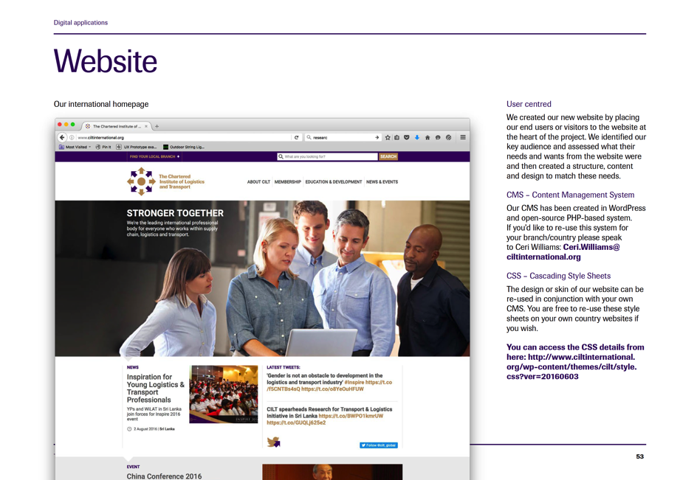
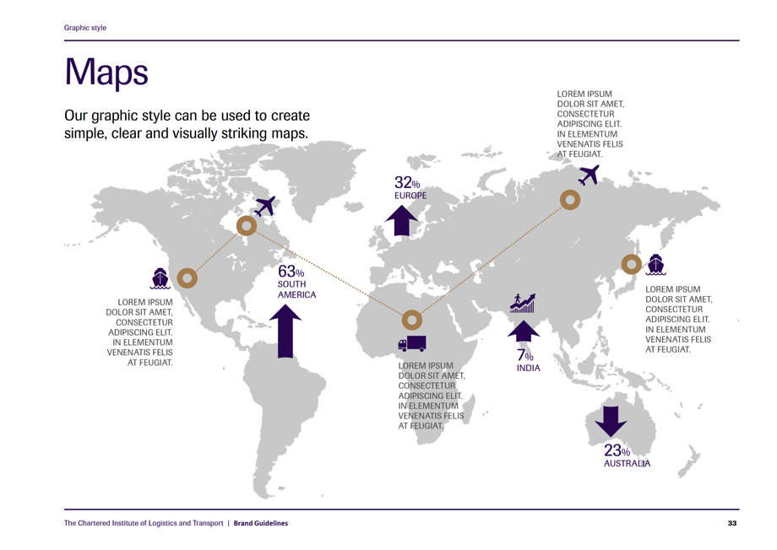

Slide 34
Brand Hub
The Brand Hub is a free central resource, launched in March 2017, that enables access to high quality CILT marketing and support materials.
Through it we are able co-ordinate all communications, and ensure a consistency of tone and imagery.
Available Materials
Brand design and tone of voice guidelines
Logos and illustrations
Brand assets such as stationery, PowerPoint and Word templates
Social media templates
Design layouts and artwork

Slide 35
Communications Platforms
Website
ciltinternational.org
Facebook
facebook.com/ciltinternational
Twitter
@cilt_global, @presidentCILT
Linkedin
linkedin.com/company/the-chartered-institute-of-logistics-&-transport
SlideShare
slideshare.net/ciltinternational
Flickr
flickr.com/photos/ciltinternational

Slide 36
Our International Strategy:
Key Strategic Focus in 2019 is “2019 and Beyond”

Slide 37
Key Strategic Focus in 2019
Celebration of our 100 years in 2019
In depth review of what works well and what doesn’t
How do we equip ourselves to do well in our second century
Trustee led
Scope to include structure, organisation, ways of working, membership, education

Slide 39
Young Professionals Forum
“We must not just enable today’s leaders, but nurture tomorrow’s”
Kevin Byrne,
CILT International President 2016 - 2018

Slide 40
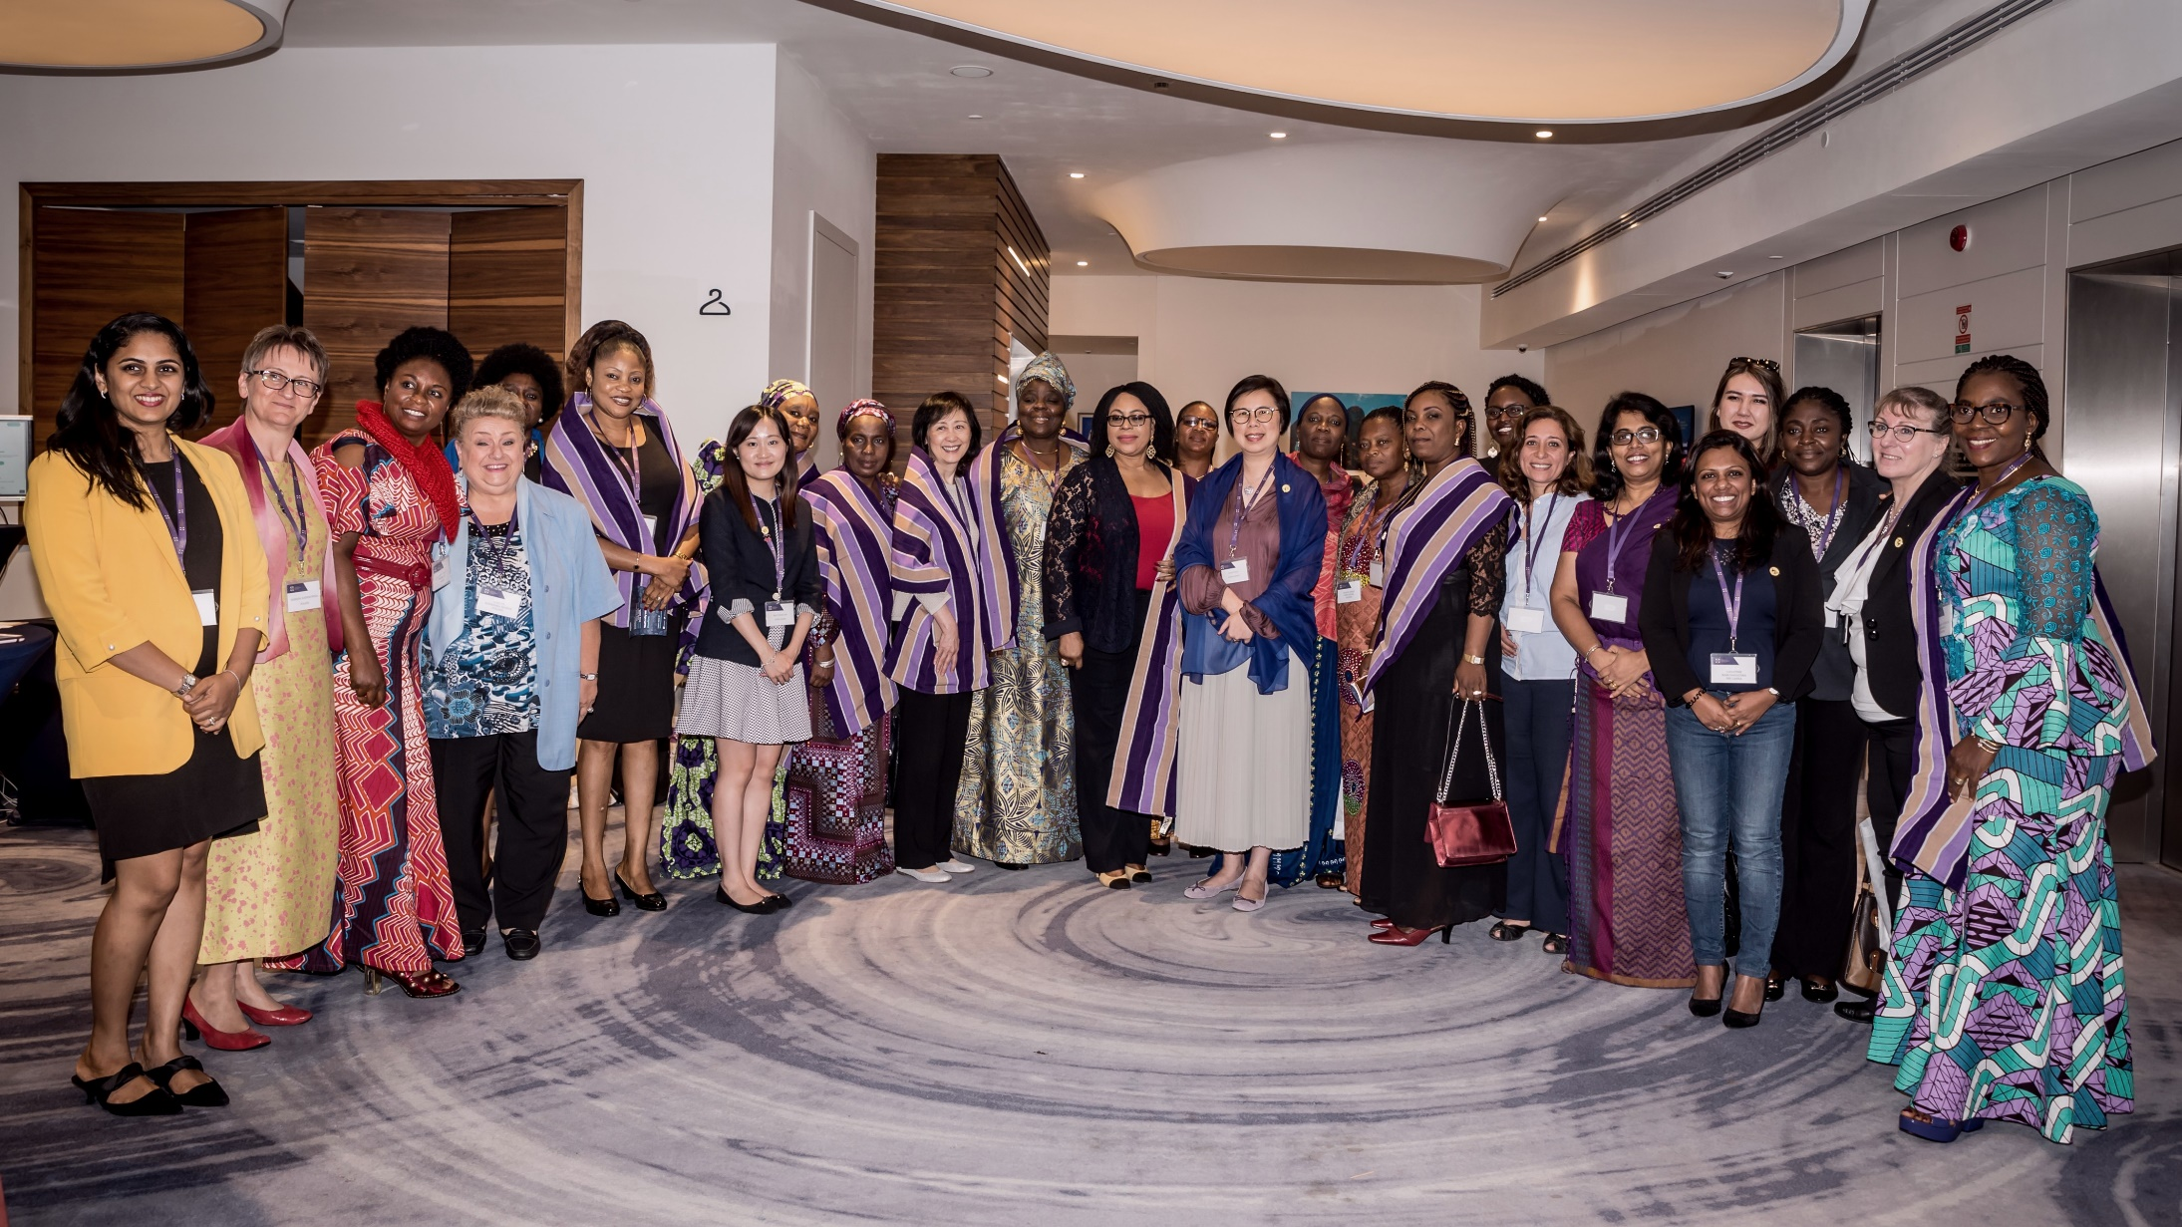
WiLAT Forum
“Cultivating a spirit of togetherness to thrive in a male dominated industry”
Aisha Ali Ibrahim,
WiLAT Global Convenor

Slide 42
International Convention
Wroclaw 2018
Over 200 delegates
From 35 Countries
22 International Speakers
4 Day Programme

Slide 43
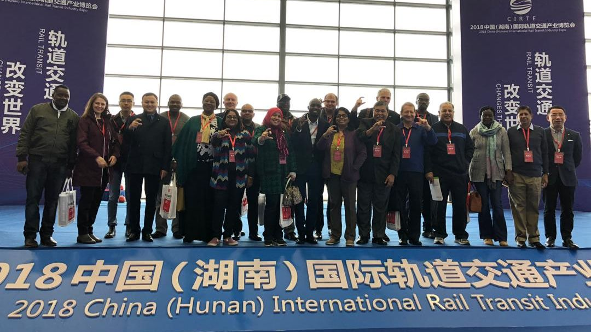
China Conference
Changsha 2018
5th China International Logistics Development Conference
Over 1000 delegates
30 CILT International Delegates
From 22 countries

Slide 44
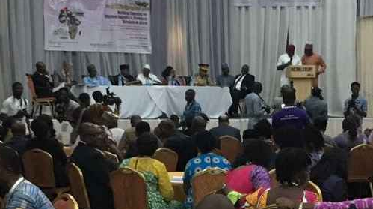
Africa Forum
Abuja 2018
Only Regional Forum so far
Organised by the Chair of the Africa Forum & the host country
400 plus attendees in March 2018
Hosted in recent years by Mauritius, Ghana, Uganda & Tanzania

Slide 45
Stronger Together
We are the leading global membership organisation for everyone who works in supply chain, logistics and transport.
We help you and your organisation gain the knowledge and insights you need in the modern world where logistics and transport skills matter.
We influence and shape government policy across many economies.
We’re now in 35 countries worldwide. Our standards and your membership status are recognised wherever you go and wherever you work.
A career partner for life. We start with students and support their careers all the way to becoming professors, government ministers and supply chain directors.

Slide 47
Keith Newton
International Secretary General
The Chartered Institute of Logistics and Transport
T: +44 (0) 1536 740162
keith.newton@ciltinternational.org

