Slide 1
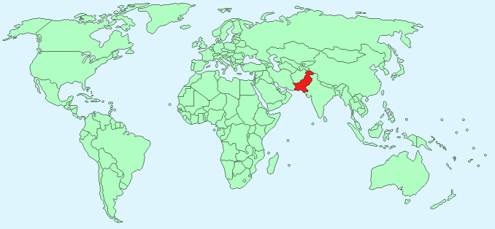
Business Plan 2016-20
of
The Chartered Institute of Logistics &
Transport (Pakistan)
Approved By:
Executive Committee
CILT Pakistan
October 01st , 2016

Slide 2
Contents
I. Introduction
A. CILT Pakistan Vision
1. Pakistan Transport Vision 2025
B. CILT Pakistan Mission
C. CILT Pakistan Values
D. CILT Pakistan Objectives
E. CILT Membership Benefits
II. Present Position of CILT Hub
A. Importance of Pakistan as Logistics Hub:
1. Pakistan Strategic Linkages
2. Logistics & Transport Sectors
3. Logistics and Transport Contribution
4. Size of Logistics & Transport Industry
5. Problems Faced by Logistics & Transport Sectors
III. Role of CILT Pakistan as an enabler
I V. Key Focus Area for CILT Pakistan
A. Membership
B. Education & Training
C. Market Leadership
V. Membership
A. Membership Issues
B. Membership state
C. Membership Strategy
D. Membership Tactics
Continued.. .. ..
1/43

Slide 3
Contents
VI. Education & Training
A. Education & Training Issues
B. Competitive Analysis
C. Education & Training Tactics
D. Market Leadership Issue
E. Market Leadership Strategy
F. Market Leadership Tactics
VII. Business Plan
A. Operational Plan
B. Marketing Plan
C. Resource Plan
VIII. Financials
A. Membership Forecast
B. Revenue Membership
C. Budget
D. Assistance for Resources
E. Request from CILT International
2/43

Slide 4
I . INTRODUCTION
3/43

Slide 5
A. CILT Pakistan Vision
To be recognized as the first choice professional body for the Supply Chain, Logistic and Transport Industry in Pakistan.
4/43

Slide 6
1. Pakistan’s Transport Vision 2020
Recognizing importance of transport in the economy, large investments and understanding is required to improve the infrastructure. The future Vision 2020 plans to focus on supporting trade and logistics services :-
ROAD:
Raising road density to 0.45km/sq.m by 2018, increasing existing road network from 2,60,000km to 3,58,000 km
Upgrade CAREC, CPEC Corridors
Strengthen Institutions and build capacity of transport agencies in areas such as road safety, strategic planning , transport policy development, road assessment management, safeguard compliance and Procurement.
5/43

Slide 7
2. Pakistan’s Transport Vision 2020 (2)
RAIL: Upgrade Railways by increasing speed from 95 to 120-140 km/hr, double tracks, increase line capacity & introduce modern signaling.
RAIL-ROAD: Develop rail-road linkages from and to Ports. Connect Gwader Port with Central Asian States, China, other neighboring countries and with main lines from Karachi to Peshawar and Karachi to Quetta and Quetta to Zahidan. Develop separate freight corridor along existing Railway tracks.
URBAN MASS TRANSPORT: Introduce Lahore Orange Line Metro train ; Green Line for Karachi (17.8 Km); Low carbon transport solutions
PORTS and SHIPPING: Deepen existing berths and construct Deep Water Ports for mother vessels with Transshipment facilities.
6/43

Slide 8
3. Pakistan’s Transport Vision 2020 (3)
AIR: Construct new Gwadar International Airport. Develop existing major airports into aerotropolis.
PIPELINES: Increase existing pipelines for transportation of liquid cargo.
LOGISTICS
Provide warehousing and logistic facilities
Establish Container Freight Stations.
Establish hubs for road transport outside the city
7/43

Slide 9
B. CILT Pakistan Mission
To promote and encourage the art and science of Logistics and Transport through its membership and educational qualifications.
8/43

Slide 10
C. CILT Values
Global Leadership (sustainability, impact & influence)
Professionalism (global focus & shared knowledge)
Inclusivity (stronger together, ownership)
Diversity (accessibility)
Dynamism (Innovation & Adaptability)
9/43

Slide 11
D. CILT Objectives
Act as the custodian of the name, brand and Royal Charter and exploit the benefits of being part of an international organization.
Promote and maintain Chartered status, standards in education and professional development.
Share knowledge in global practices in Logistics and Transport, both internally and externally.
Establish relationships with relevant local and international organizations.
Provide strategies that support local membership growth and other activities, including regional coordination,
Provide professional and authoritative views on transport and logistic policy issues.
10/43

Slide 12
E. CILT Membership Benefits
1. Enables opportunity of meeting others in the transport and logistics spheres at CILT gatherings and enhance their knowledge with the most up to date information on current developments and future possibilities.
2. Enables joining other Logistic and transport professionals.
3. Entitles receipt of Newsletters to keep members abreast on issues in the industry and on updates on the institute.
4. Entitles access to Knowledge Centre.
5. Provides access to the Library which has all relevant transport and logistics up to date reference books and magazines for knowledge enhancement.
6. Entitles 50% concession by Pakistan Railways within the country.
11/43
Notes:
Members across the CILT global family can follow international news and events by using the following social media links :
Website: www.ciltinternational.org ; Facebook: https//www.facebook.com/ciltinternational/; Twitter:https//twitter.com/cilt global; Flickr://www.flickr.com/photos/134390998@NO6/albums

Slide 13
E. CILT Membership Benefits (2)
7. Sets highest standards of professional practice through education, a comprehensive qualifications framework, career experience , professional grades and continuing professional development.
8. Entitles use of CMILT and FCILT after their name which attaches prestige and proof of high level of professional experience.
9. Offers internationally recognized qualifications in transport and logistics for career advancement and promotions, from Level1-6 as full courses and Level 1-5 as single modules.
10. Supports Continuing Professional Development.
11. Offers a number of Grants and Sponsorships.
12. Shares best practices across the world.
13. Promotes opportunities of life long learning.
14. Advocates policies for sustainable Logistics and Transport.
15. Entitles attendance at meetings and functions.
16. Entitles discount prices at conferences and Institute activities.
12/43

Slide 14
II. Present Position
Importance of Pakistan as a Potential Regional
Transportation and Logistics Hub
13/43

Slide 15
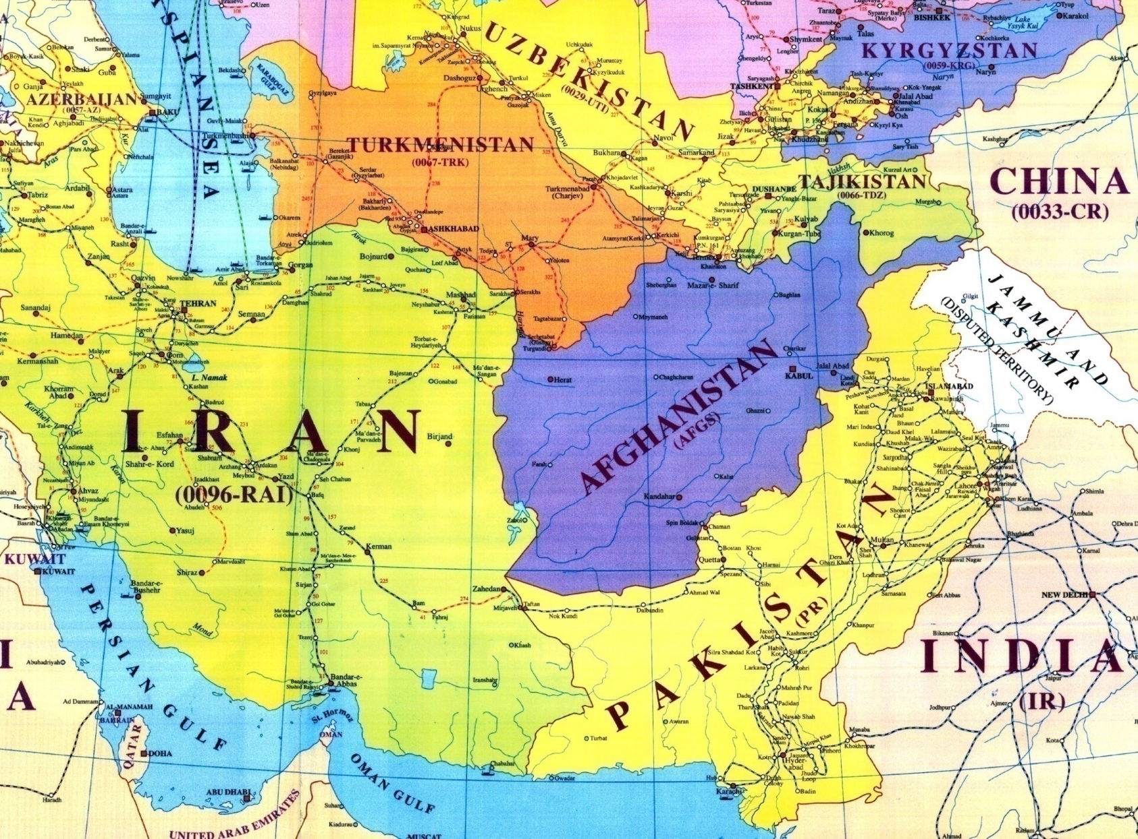
(1)
To Turkey &
Europe
Pakistan’s
Strategic
Linkages
Khunjerab
Mashad
Jalalabad
Havelian
Herat
Peshawar
Esfahan
Amratsar
Lahore
Quetta
Zahidan
Taftan
Mastung
Munaba
Gwadar
Karachi
14/43
Notes:
1. Pakistan is the 6th most populous country with a population of 199 million and the 36th largest country in the world in terms of area i.e. 881,913 sq.km.
Bordered by:
a) India to the East,
b) Afghanistan to the West,
c)Iran to the South west and
d) China to the far North East,
it is separated from Tajikistan by Afghanistan’s narrow Wakhan in the North
and shares the maritime border with Oman.
3. Pakistan is gifted with a strategic location which is well suited as a hub of commercial activity.
4. Its coastline runs over 1046Km (650 miles) along the Arabian Sea and Gulf of Oman with an unexplored offshore exclusive economic zone covering 2,40,000 sq.km.
5. Transport industry accounts for 10.5 % of the nations GDP of $ 930.8 billion and almost 33% of contribution to the services sector and accounts for over 6% of employment. Consumes 35% of the total energy annually.

Slide 16
2. Logistics and Transport Sectors
Current Logistic and transport sector in Pakistan comprises of both physical and soft infrastructure.
Physical Infrastructure: Road, rails, Sea, Air, Pipelines and related passenger and freight facilities.
Soft Infrastructure: Packaging, delivery, storage, trade logistics and facilitation.
15/43

Slide 17
3. Logistics & Transport Contribution
a. Transport industry in Pakistan:
i. contributes about 10 % to GDP of $ 930.8 billion
ii. makes 33% contribution to the services sector
iii. accounts for over 6% of employment.
iv. consumes 35% of the total energy annually
b. The transport system in Pakistan is in poor condition, with an estimated cost to the economy of 8.5% of gross domestic product.
c. Upgrading of Pakistan’s transportation system is critical to export competitiveness and economic growth
16/43

Slide 18
4. Size of Logistics & Tpt. Industry
ROAD
RAIL
SEA:
DRY PORT:
predominant mode of transport
92% of passenger
network of 7791 route km,
Coastline runs over 1046Km (650 miles) along the Arabian Sea and Gulf of Oman
14 Dry ports across the country to cater to high value external trade.
a road network of 263,000 km.
96% of freight traffic.
452, locomotives,
1732 passenger coaches and
15948 freight wagons but carries
5% of the traffic. Passenger services
offshore exclusive economic zone covering 240,000 sq.km.
3 major Ports i.e. Karachi Port Trust , Port Qasim and Gwadar Port that
95% of all international trade.
CPEC:
CAREC:
Central Asian Regional Economic Cooperation (CAREC) Program connecting Afghanistan, CA states, & China to Lahore, Islamabad and Gwadar & Karachi Ports.
The China Pakistan Economic Corridor (CPEC) is being developed from Gwader Port in Baluchistan to serve as the gateway to Central Asian States, China, Iran, Afghanistan and Europe. Iran has given its agreement to participate in CPEC.
URBAN TRANSPORT:
Metro Bus Service (22.5 km) from Islamabad to Rawalpindi operational 2015. Metro Bus service in Lahore in also in operational.
Pipelines running across 50% length of the country.
PIPELINES
Metro Bus service and Metro Train in Lahore, Multan, Karachi and Khyber Pakhtoonkhan are in progress.
LOGISTICAL FACILITIES
In land Container Depos at major cities are available.
Warehousing facilities available in major cities.
Container Terminal facilities at Port of Gwadar, Port Qasim and Karachi Port are available.
Packaging, Storage and Logistics facilities are available.
AIR:
Pakistan has 46 Airports
10 are international.
17/43
Notes:
Additional Notes:
ROAD:
The Inland traffic by road transport is estimated at 325 billion passenger-km.

Slide 19
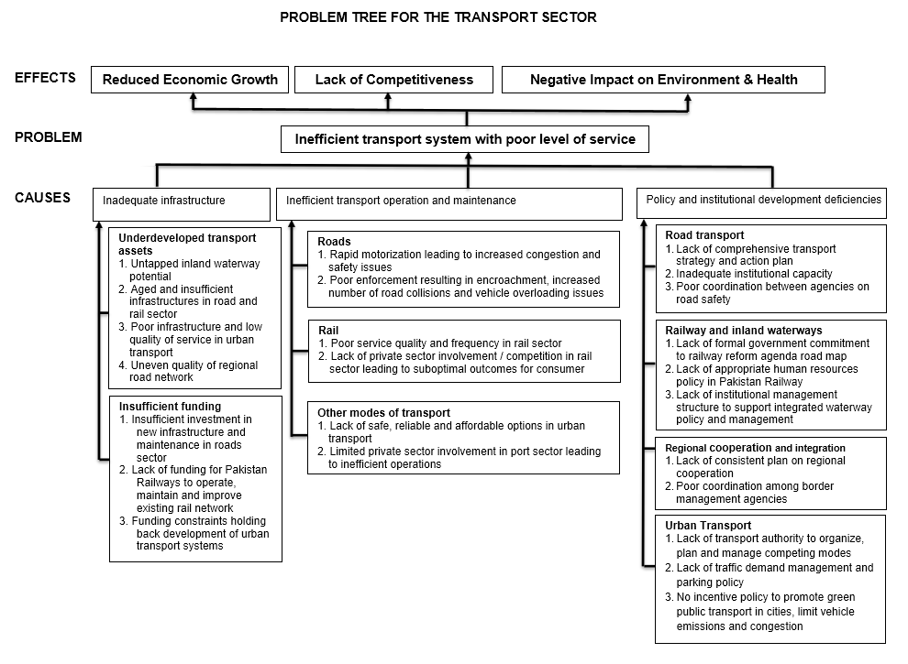
Problems of the L&T Sectors
(5)
18/43

Slide 20
III. Role of CILT Pak as an Enabler
A. CILT International is the leading professional global body that has rigorously developed qualifications to match overall standards needed to develop logistics and transport professionals across the world.
B. Through association with CILT INT, CILTPAK can:
1. Assist existing professionals in L&T industry to grow by providing access to knowledge, intelligence, training on global standards, benchmarks for operating in the highly competitive environment.
2. Develop standards from basic level, supervisory or team leader roles, to management, professional and technical specializations.
3. Provide career opportunities.
4. Provide Global connections and act as a showcase platform for organizations
5. Nurture the next generation of L&T professionals through World Class Education Standards.
19/43

Slide 21
IV. Key Focus Areas for CILT Pak
A. Focus Area 1: Memberships
Increase Memberships by Developing Targeted Programs
B. Focus Area 2: Education & Training
Create Awareness and Develop Partnerships for Education and Training (thus increasing student engagement)
C. Focus Area 3: Market Leadership:
Long term goal to establish CILT members as Leaders for T&L
20/43

Slide 22
V. Membership
21/43
Notes:
Membership – are there any opportunities in focused development of YP and WiLAT groups? Can these be linked to the region / other CILT countries?
Membership - does there need to be supporting emphasis on creating capability in the CILT Office?
Membership - does there need to be supporting emphasis on creating capability in the CILT Office? –Yes we need a marketing department to help set up marketing material ( website, print, newsletter, other), memebership drive visits and presentations, dedicated conferences. MBA marketing/ SC is required preferable with a few years of experience. Expected salary range around PKR 100-150K depending upon experience
and Program Management Department

Slide 23
A. Membership Issues
1. Membership is increasing at a slow rate.
2. Turn out of Members is very high.
3. Older Members pay their dues late.
4. To enhance perception of market value of membership needs proper marketing and proper programming/ Product Delivery.
22/43
Notes:
Membership – are there any opportunities in focused development of YP and WiLAT groups? Can these be linked to the region / other CILT countries?
Membership - does there need to be supporting emphasis on creating capability in the CILT Office?
Membership - does there need to be supporting emphasis on creating capability in the CILT Office? –Yes we need a marketing department to help set up marketing material ( website, print, newsletter, other), memebership drive visits and presentations, dedicated conferences. MBA marketing/ SC is required preferable with a few years of experience. Expected salary range around PKR 100-150K depending upon experience
and Program Management Department

Slide 24
B. Memberships State
 | YEAR ( As of 30/06/20--)
MEMBER CATEGORIES | 2012 | 2013 | 2014 | 2015 | 2016
FCILT* | 115 | 131 | 147 | 147 | 158
CMILT* | 851 | 952 | 1002 | 1036 | 1151
MILT | 80 | 58 | 80 | 85 | 108
AFT | 21 | 11 | 14 | 14 | 40
Corporate | - | - | - | - | -
Students | - | - | - | - | -
 | 1067 | 1152 | 1243 | 1282 | 1457
*Includes the Following
Life Members - FCILT |  |  | 145 | 147 | 147
Life Members - CMILT |  |  | 529 | 538 | 538
23/43

Slide 25
C. Membership – Strategy (1)
1. Develop better Product/Service offering: Provide greater Value and Services to members by increased networking ( international/Local), learning and speaking opportunities ( More seminars and exchange programs)
2. Revamp Membership Offering – Include Knowledge Center, International Offerings
3. Increase specialized knowledge groups/ committees for Youth and Women Groups.
24/43

Slide 26
C. Membership–Strategy (2)
1. Find current needs and requirements of market and develop programs around it. ( Survey and Validation of Assumptions)
2. Develop 5 year Marketing Plan to Increase Membership.
3. Approach Universities to partner with CILT.
4. Develop CILT and Industry linkages to enhance its membership value.
5. Begin a Corporate Partnership/Membership Schemes:
a. Increase Corporate Engagement for CILT
b. Offer Skill development courses for lower level jobs
c. Job exchange bank ( online)
25/43
Notes:
Membership – are there any opportunities in focused development of YP and WiLAT groups? Can these be linked to the region / other CILT countries?
Membership - does there need to be supporting emphasis on creating capability in the CILT Office?
Membership - does there need to be supporting emphasis on creating capability in the CILT Office? –Yes we need a marketing department to help set up marketing material ( website, print, newsletter, other), memebership drive visits and presentations, dedicated conferences. MBA marketing/ SC is required preferable with a few years of experience. Expected salary range around PKR 100-150K depending upon experience
and Program Management Department

Slide 27
D. Membership – Tactics
1. Revamp Marketing.
2. Develop new marketing and branding material: Print & Web Side
3. Program Management Committees: Need an events department to spearhead events calendar.
4. Need at least 1-2 fulltime persons to lead overall membership drive.
5. Need to have elected committees accountable for targets.
26/43
Notes:
Membership – are there any opportunities in focused development of YP and WiLAT groups? Can these be linked to the region / other CILT countries?
Membership - does there need to be supporting emphasis on creating capability in the CILT Office?
Membership - does there need to be supporting emphasis on creating capability in the CILT Office? –Yes we need a marketing department to help set up marketing material ( website, print, newsletter, other), memebership drive visits and presentations, dedicated conferences. MBA marketing/ SC is required preferable with a few years of experience. Expected salary range around PKR 100-150K depending upon experience
and Program Management Department

Slide 28
VI. Education & Training
A. Education and Training Issues
1. The Number of professional service providers are few ( None Provide International Certification)
2. There are only 3 programs which CILT Pakistan is running at present with the cooperation of Educational partners.
3. Student Members are not fully aware of benefits of CILT memberships.
4. CILT Members are not aware of CILT International resources that are available.
27/43
Notes:
Education and Training - does there need to be supporting emphasis on creating capability in the CILT Office?
Education & pricing for the market – should this be a specific area to work on as part of the business plan. Could you work with a potential supplier as part of the business plan to develop a proposed strategy? Could you use some of the wider products available internationally in our Global Training Directory? Is CILT Malaysia able to directly support (Dato?)

Slide 29
B. Competitive Analysis
Some institutes offering degrees and courses in Supply Chain Management in Pakistan, however none of these give international certification
1.5 – 3 Year Degree Programs
Bahria University
SCM Courses
National University of Modern Languages
Muhammad Ali Jinnah University
Lahore Leads University
The Superior University
The University Of Lahore
University Of Management &Technology
Al-hamd Islamic University
Institute of Business Administration
Shaheed Zulfiqar Ali Bhutto Institute of Science and Technology
NED
LUMs
Iqra
Institute of Business Management
Pakistan Institute of Management
Pakistan Institute of Freight Forwarders Association
Supply Chain Capacity Development Initiative
3 Educators
TCS
NUST
International Islamic University Islamabad
Virtual University of Pakistan
Hamdard University
COMSATs university of Technology
Mohammad Ali Jinnah University
Bahauddin zakaria University Multan
Institute of Mangement sciences
DHA Sufa University
Institute of Business and Technology BIZTECH
Sindh Madarasatul Islam
Many other small and big institutes.
CILT –CPD Programs
Burraq Associates
Pakistan Enterprises Development Foundation
ISPS
International Islamic University
University of Karachi
28/43
Notes:
Additional Institutes offering SCM Courses Only
Institute of Business Administration
Shaheed Zulfiqar Ali Bhutto Institute of Science and Technology
NED
LUMs
Iqra
Institute of Business Management
Pakistan Institute of Management
Pakistan Institute of Freight Forwarders Association
Supply Chain Capacity Development Initiative
3 Educators
TCS
NUST
International Islamic University Islamabad
Virtual University of Pakistan
Hamdard University
COMSATs university of Technology
Mohammad Ali Jinnah University
Bahauddin zakaria University Multan
Institute of Mangement sciences
DHA Sufa University
Institute of Business and Technology BIZTECH
Sindh Madarasatul Islam
Many other small and big institutes.

Slide 30
C. Education & Training – Tactics
1. Employ a Program Manager to manage education initiatives. Key job requirements would be to manage training providers and develop Education products localized to market requirements. In addition, market to training providers and manage the accreditation process and streamline student management.
2. CILTPAK needs CILT INT support in capacity building of master trainers and International Level Programs.
29/43
Notes:
Education and Training - does there need to be supporting emphasis on creating capability in the CILT Office?
Education & pricing for the market – should this be a specific area to work on as part of the business plan. Could you work with a potential supplier as part of the business plan to develop a proposed strategy? Could you use some of the wider products available internationally in our Global Training Directory? Is CILT Malaysia able to directly support (Dato?)

Slide 31
D. Market Leadership - Issue
1. Although CILT Pakistan membership is moderate, however improvement is always encouraged.
30/43
Notes:
Market Leadership – should development of policy include a link to government - NO CAPACITY AT THIS STAGE
Market Leadership – is there any opportunity for partnerships with other organisations who are not direct competitors such as industry / sector groups?

Slide 32
E. Market Leadership - Strategy
1. Increase Visibility as a Key Opinion Leader Organization/ Knowledge Partners
2. Introduce Research and Policy development activity through working with CILT approved universities
3. Provide opportunities for student secondment and dissertation research Provide visibility through international speaking opportunities at key conferences and trade shows
4. Enable growth in local capability to influence policy and industry standard at the local level.
31/43
Notes:
Market Leadership – should development of policy include a link to government - NO CAPACITY AT THIS STAGE
Market Leadership – is there any opportunity for partnerships with other organisations who are not direct competitors such as industry / sector groups?

Slide 33
F. Market Leadership – Tactics
1. It is felt that this will take time to gestate.
2. While this should be a long term goal there are currently few resources that can truly mobilize CILT for this.
3. Key activities will be dependent upon developing Focus area 1 & 2. With this it is hoped that market leaders can be roped in to speak on behalf of CILTPAK and CILT International.
4. For developing Leadership, suggest getting corporate support to sponsor 1-2 Key Government or Corporate Leaders to attend International Forum or to invite International Speakers locally.
32/43
Notes:
Market Leadership – should development of policy include a link to government - NO CAPACITY AT THIS STAGE
Market Leadership – is there any opportunity for partnerships with other organisations who are not direct competitors such as industry / sector groups?

Slide 34
VII. Business Plan
33/43

Slide 35
A. Operational Plan
1. Survey – for Customer Needs
2. Revamp Product/Services Offering:
3. Revamp Membership Pricing
4. Membership Drive
5. Suggested targeted offering for market needs
a. Accreditation of Partners
b. Corporate Memberships
c. CPD Programs
d. Events Plan
e. Digital Library
f. Other
34/43

Slide 36
B. Marketing Plan
1. Update CILT Brand Collateral
a. Print Material
b. Website.
c. Social Media Awareness Campaigns ( Facebook, Twitter, Blog, Whatsapp, Viber, others)
2. Plan & Sustain Social Media Presence
3. Develop a Seminar & Conference Calendar
4. Make a Marketing Budget for Advertising/Stalls in Key Conferences
5. Prepare a Public Relations Plan
35/43

Slide 37
C. Resourcing Plan: Proposed Organization Chart
Chairman
Treasurer
Members subcommittee
( 18 Seats )
Marketing & Membership Coordinator
Administrator
Marketing & Membership Officer
Joint Secretary
Guard
Office Peon
Education & Training
(3 seats)
Membership
(3 seats)
Building & Fund Raising
(3 seats)
Social and Professional Activities (3 seats)
Accounts (3 seats)
Librarian
Accountant
Policy Research Coordinator
Knowledge Center officer
Marketing (3 seats)
Education officer
Education & Training Coordinator
Vice Chairman
Secretary & CEO
Honorary Advisor
Legend
Honorary Positions
Paid Positions
36/43
Notes:
Organisation – are these current? Would you propose any change to the roles / committees? For example you could have 3 committees that match the 3 Key Focus areas and remove some of the others? This would mean I think elevating Marketing (if that covers Market Leadership) to level of Education and Membership and then subsuming the other sub committees into the three?
Organisation – is there a capability issue in the office that needs to be overtly worked on? Are the office staff able to take advantage of web and social media and use and communicate actively through these mediums? Does this area need to be highlighted as a need for change? (my views based on feedback from Saquib on the education responsiveness & from my view of CILT globally – the best countries are very effective in using the new mediums, the worst have no capability and outdated websites!)

Slide 38
VIII. Financials
37/43

Slide 39
A. Membership Forecast
Membership Categories | 2016 (Actuals) | 2016 to 2017 YOY Increase (Target) | 2017 | 2017 to 2018 YOY Increase (Target) | 2018 | 2018 to 2019 YOY Increase (Target) | 2019 | 2019 to 2020 YOY Increase (Target) | 2020
FCILT | 158 | 5% | 166 | 5% | 174 | 5% | 183 | 5% | 192
CMILT | 1151 | 20% | 1381 | 20% | 1657 | 20% | 1690 | 20% | 2028
MILT | 108 | 20% | 130 | 20% | 156 | 20% | 187 | 20% | 224
AFT | 40 | 25% | 50 | 25% | 63 | 25% | 79 | 25% | 99
Corporate | 0 | 0 | 0 | 0 | 0 | 0 | 0 | 0 | 0
Students | 0 | 0 | 0 | 0 | 0 | 0 | 0 | 0 | 0
Total | 1457 | - | 1727 | - | 2050 | - | 2139 | - | 2543
38/43

Slide 40
B. Revenue - Memberships
Revenue in Rupees
 |  | 2015 |  | 2016 |  | 2017 |  | 2018 |  | 2019 |  | 2020
 | Rates (Rs.) | Members | Income | Member | Income | Member | Income | Member | Income | Member | Income | Member | Income
FCILT | 2,500 | 147 | 367500 | 158 | 395000 | 167 | 417,500 | 171 | 427500 | 180 | 450000 | 189 | 472500
CMILT | 2,000 | 1036 | 2072000 | 1151 | 2302000 | 1492 | 2984000 | 1790 | 3580000 | 2148 | 4296000 | 2578 | 5156000
MILT | 1,500 | 85 | 127500 | 108 | 162000 | 123 | 184500 | 148 | 222000 | 178 | 267000 | 214 | 321000
AFT | 1,000 | 14 | 14000 | 40 | 40000 | 23 | 23000 | 29 | 29000 | 36 | 36000 | 45 | 45000
CORPORATE | 300,000 | - | - | - |  | - | - | - | - | - | - | - | -
Students | 1,500 | - | - | - | - | - | - | - | - | - | - | - | -
TOTAL MEMBERS/ Income |  | 1,282 | 2581000 | 1457 | 2899000 | 1805 | 3609000 | 2138 | 4258500 | 2542 | 5049000 | 3026 | 5994500
Actual / Expected Collections about 40% |  |  | 1093864 |  | 1159600 |  | 1443600 |  | 1703400 |  | 2019600 |  | 2397800
CILT PAK SHARE |  |  | 850885 |  | 845396 |  | 987760 |  | 1112029 |  | 1263801 |  | 1445013
CILT INT SHARE | 407 | 597 | 242979 | 772 | 314204 | 1120 | 455840 | 1453 | 591371 | 1857 | 755799 | 2341 | 952787
39/43

Slide 41
C.
 |  | Actual | Forecast
 |  | 2015 | 2016 | 2017 | 2018 | 2019 | 2020
INCOME
Memberships |  | 1093864 | 1159600 | 1443600 | 1703400 | 2019600 | 2397800
Education & Training |  | 390,315 | 429346 | 472280 | 519508 | 571458 | 628603
Accreditation
Certification
Knowledge Centre Fee
Net Profit from Events
TOTAL INCOME |  | 1484179 | 1588946 | 1915880 | 2222908 | 2591058 | 3026403
EXPENSES
Payroll |  | 617,300 | 5,232,000 | 5,820,000 | 7,320,000 | 9,120,000 | 9,120,000
Direct Program Expenditures |  | 432,208 | 800,000 | 800,000 | 1,200,000 | 1,500,000 | 1,500,000
Marketing |  |  | 800,000 | 1,200,000 | 1,500,000 | 1,800,000 | 1,800,000
CILT International Fees |  | 242979 | 314204 | 455840 | 591371 | 755799 | 952787
CILT Knowledge Centre /Digital Library |  |  |  | 48,300 | 48,300 | 48,300 | 48,300
Admin Overheads |  | 479438 | 600,000 | 1,000,000 | 1,200,000 | 1,400,000 | 1,600,000
TOTAL EXPENSES |  | 1292487 | 7146204 | 8324140 | 10659671 | 13224099 | 13421087
PROFIT AND LOSS |  | 191692 | - 5557258 | - 6408260 | - 8436763 | - 10633041 | - 10394684
 | Memberships Figure does not include liability as only 50 have paid their dues
Budget
40/43

Slide 42
D. Assistance for Resources
1. Hire one senior level paid Secretary and Program Coordinator.
2. Provide Digital Library Access
3. Provide regular guidance to develop CILT Pakistan Accreditation System
4. Assist in helping develop new products
41/43

Slide 43
E. Request from CILT International
Lynchpin Activities | Cost per Annum | Cost for 2 Years
Hire two senior level paid Program Coordinator @ Rs 150,000/person /month | 36,00,000 | 72,00,000
Marketing Material Development Website, Social Media, Print Collateral Rs. 500,000 / annum | 500,000 | 1,000,000
PR Events and Seminars | 2,300,000 | 4,600,000
Provide Digital Library Access
Provide regular guidance to develop CILT PAK Accreditation System
Assist in helping develop new products
TOTAL (PKR) | 64,00,000 | 1,28,00,000
42/43

Slide 44
Thank You
43/43

