Slide 2
Celebrating in style
We are celebrating much more than 100 years of existence. As a membership organisation, everything we do is about supporting our members and their development as industry professionals. The Centenary provides a perfect opportunity to reinforce our values, and promote the benefits of belonging to the Institute, and being part of our shared future.
As we celebrate our heritage, we take the opportunity to remind members and potential members why we remain relevant, and how we can support them (and the work they do), today and tomorrow. Over the course of the year we will be focussing on our members around the world, and their individual membership stories.
Our initial awareness campaign supports this with simple positive messaging communicating why our members are proud to be part of CILT and what their membership means to them. The campaign offers simple, succinct and powerful messaging, is human, inclusive and representative of our membership, and uses real people with real messaging on the benefits of belonging.

Slide 3
Implementing the campaign
Campaign launched on international website and social media platforms on 3 April, supported by international news articles, and branch / IMC communications
Campaign guidelines and artwork for application of campaign to websites, social media platforms, branch stationery, presentations, events, and advertising platforms shared with branches
Branches asked to apply international campaign locally or to produce their own variations using locally relevant imagery and copy lines to suit the local market
International campaign updated weekly initially, now fortnightly, and will over the course of the year represent all sectors of our membership

Slide 4
International variations
3 April – 12 June 2019

Slide 5
International variations

Slide 10
Local Variations
3 April – 12 June 2019

Slide 11
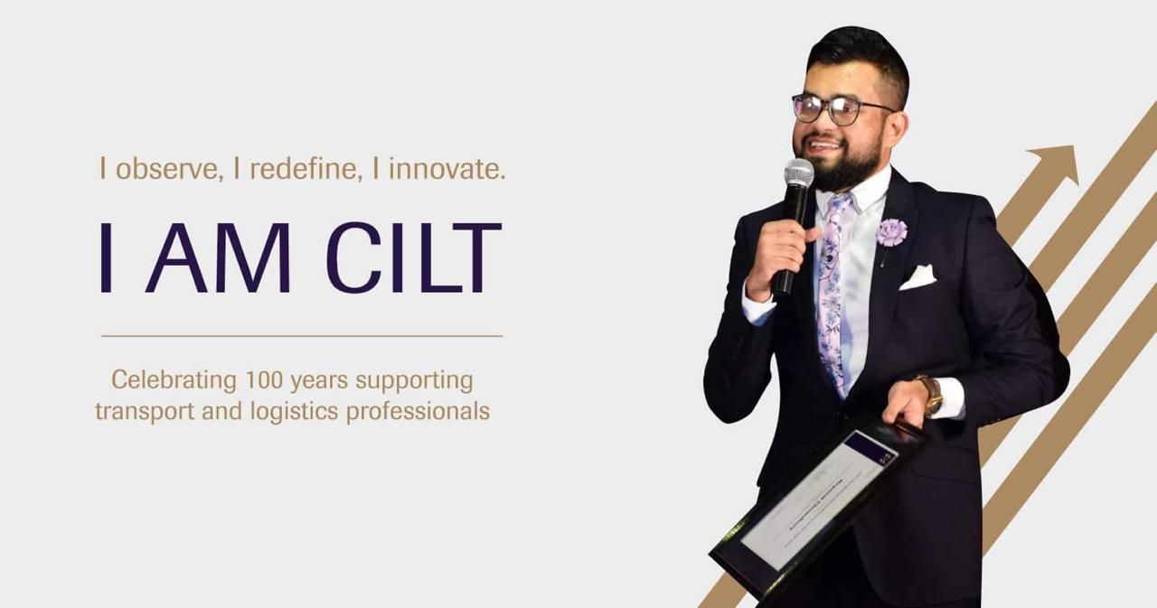
CILT Bangladesh

Slide 12
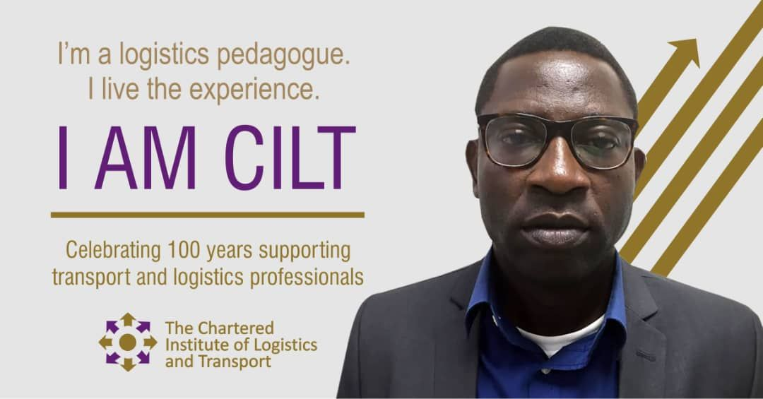
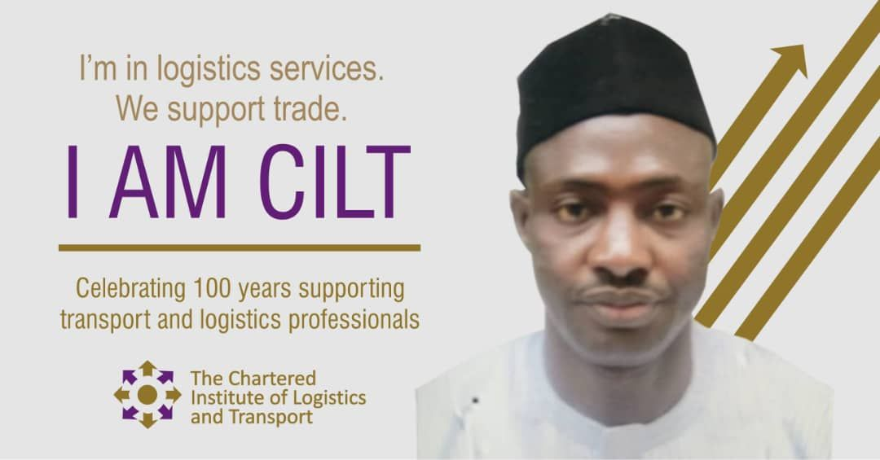
CILT Nigeria

Slide 13
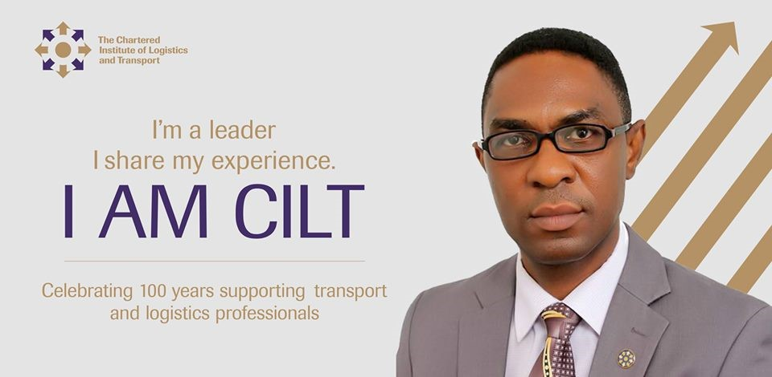
CILT Ghana

Slide 14
CILT Malaysia

Slide 15
CILT Ukraine

Slide 16
CILT India

Slide 17
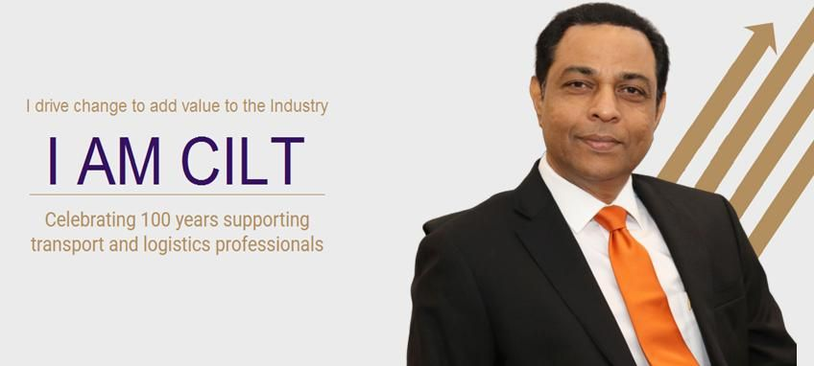
CILT Sri Lanka

Slide 18
CILT Pakistan and Indonesia
(work in progress)

Slide 19
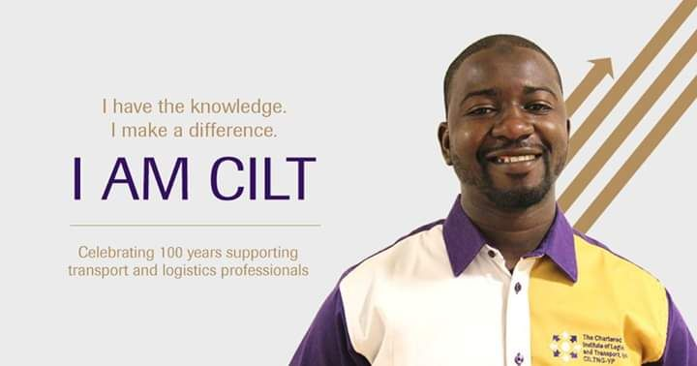
CILT YP Forum

Slide 20
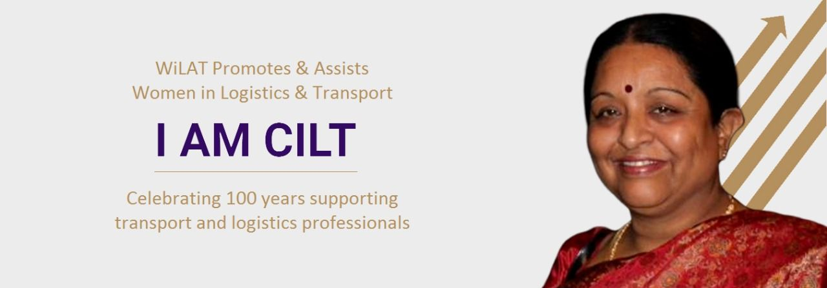
WiLAT Forum

Slide 21
Other applications – 3rd party support in Sri Lanka

Slide 22
Other applications – CILT China

Slide 23
Other applications – video in Nigeria

Slide 24
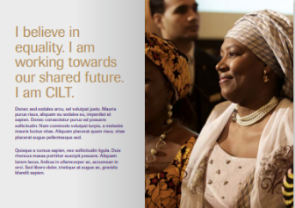
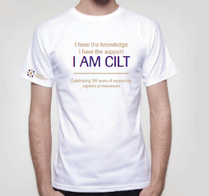
Other applications

Slide 25
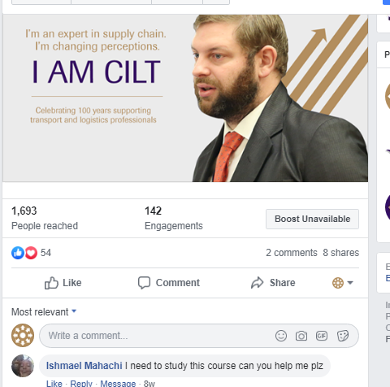
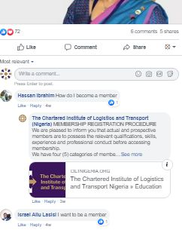
Engagement

Slide 26
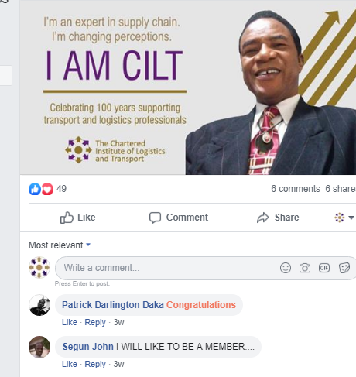
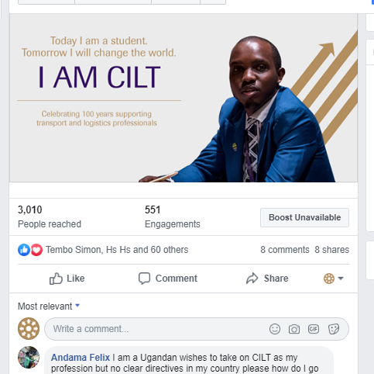
Engagement

Slide 27
Coming soon
International Member Benefits Literature

Slide 28
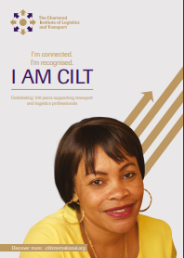
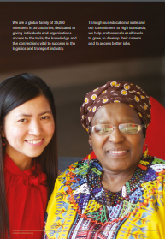
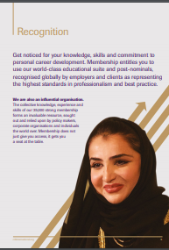
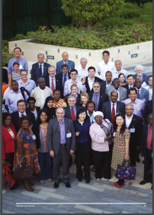
Member Benefits Literature

Slide 29
Coming soon
100 Member Stories

Slide 30
100 Member Stories

Slide 31
100 stories
Every branch has been asked to submit member stories (written and video format) from 3 members:
- One Young Professional
- One mid career member
- One Fellow
Stories will be shared on the international website, Youtube channel and social media channels over the course of the year
The campaign is due to launch after Convention and run until the end of the year
Video clips will be selected for the I am CILT video to be launched at the Savoy event in November

Slide 32
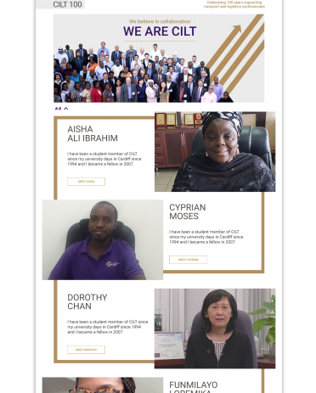
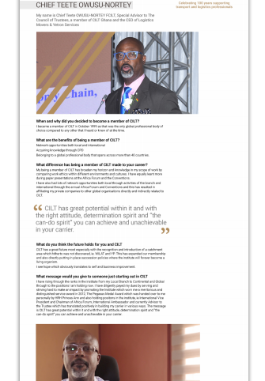
CILT 100

Slide 33
Coming soon
The Savoy Centenary Celebration

Slide 34
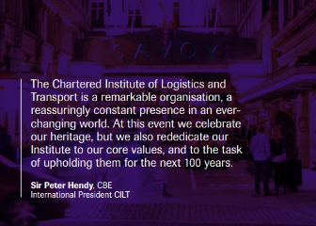
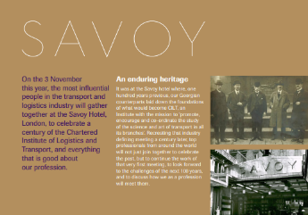
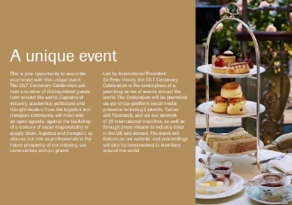
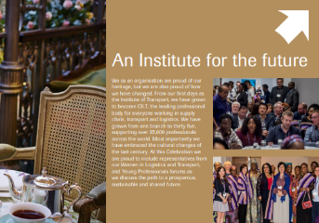
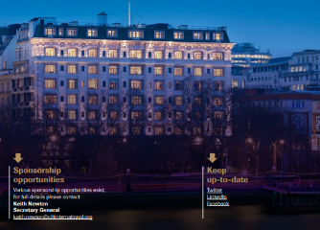
The Savoy

Slide 35
Ceri Williams
International Marketing, Governance and Communications Manager
Jasper Cook
International Communications Co-ordinator

