Slide 1
Business Plan 2020 – 2022
CILT Australia

Slide 2
Our International Priorities for 2016 – 2017
CILT is the leading professional body for Logistics and Transport specialists the world over. A family of over 35,000 members, the Institute seeks to promote excellence and understanding through education, supporting industry professionals and providing opportunities for continuous career development.
This Plan is set in line with the Growth Strategy set out by CILT International in Montreal 2016

Slide 3
2016 - 2022 CILT lnternational Priorities
Creating the Pathway to be the leading Professional Organisation for all in
Supply Chain, Logistics and Transport
Partner for Life
First Choice in the Profession
3 Year growth targets
Focus Markets
Global Capabilities
Regional & Global Structures
Fit for Future Growth
Measures
GROWTH
CAPABILITY
GOVERNANCE
Priorities
c
“Creating & Championing the programmes for growth in countries and regions”
“Service Provision in Education, Membership & Finance”
“Guardianship of the Charter & Leadership of the Institute ”
Objectives
Regional Structures developed & implemented in 2 regions – Africa & SE Asia
Membership growth focus in countries with 3 year trends & targets
Global Corporate Membership Programme created
Delivery Focus on Education providers & growth of business
Global Marketing of Education products - focus on how & the delivery of growth
Corporate Growth in China supported & developed
India Growth plan created & agreed with CILT India
Global Corporate approach agreed
Global Membership Database capability begun
Branch in a Box functionality in place
International database & email systems set up
Web site language capability
Existing & New branch sites created
Senior Members Network
Education Processes embedded & enforced
IMC role & membership developed into an effective unit
IVP roles reviewed alongside regional developments
Supporting the creation of value by reviewing & developing global relationships between countries, regions and International & working further on their definition and governance
Review of Delegation Agreements & audit capabilities in light of East African issues
First Choice for Transport & Supply Chain Professionals

Slide 4
International Priorities 2016 - 2022
Regional Structures developed & implemented in 2 regions – Africa & SE Asia
Membership growth focus on countries with 3 year trends and targets
Global Corporate Membership Programme created
Delivery Focus on Education providers & growth of business
Global Marketing of Education products - focus on how & the delivery of growth
Corporate Growth in China supported & developed

Slide 5
CILT Australia’s Background
Established in 1935 ands traditionally had a focus on training delivery.
Overtime CILTA moved away from Training and Development and aligned to Training Providers
Over the last 3 years we have been developing the Centre for Continued Professional Development and have over 100 Traditional and Private training organisation providing training services in a wide range of areas.
Governments of Australia are focussing on training and innovation and see a need to upskill and train Australian’s and have launched a wide range of campaigns to address this area. This provides opportunities for CILT Australia

Slide 6
CILT Australia’s Vision
“Creating the Pathway to be the leading Professional Organisation for all in Supply Chain, Logistics and Transport”
”

Slide 7
CILT Australia’s Objectives
Increase the profile and brand of CILT in Australia and the Philippines
Strengthen the State Sections and rollout the Philippines
Consolidate our Defence relationship
Conduct Membership Campaigns
Continue to seek new Sponsors, Corporate Memberships and Peer Groups
Continue to grow the Education directory and services

Slide 8
National Priorities 2020 - 2022
Strategy 1 - Focus activities on Membership Attraction, the value proposition and membership Retention
Strategy 2 - Establish the Education Directory as the Cornerstone of CILT Australia
Strategy 3 – Engage with other Corporate Partners and Sponsors when planning activities
Strategy 4 – Financial – Identify alternative revenue streams to Membership for CILT Australia
1.1 Build and sustainable valued Memberships for CILT Australia and Philippines.
1.2 Provide regular Industry updates
1.3 Promote industry events in all States
2.1 Course certification –assessment and process management against Key Knowledge Areas (KKAs)
2.2 CPD Management, resourced to meet the demands of CILT-A members
2.3 Mentoring of WiLAT/YP and Philippine New Member
3.1 Develop Partner Programs of mutual benefit for CILT Australia and Partners
3.2 Review Tiered Sponsorship Package for attracting new Corporate Memberships/Sponsors
3.3 Identify sponsorship opportunities in support for CILT International Convention and other Events
4.1 Manage business operations and contain operational costs
4.2 Manage the design and functionality of the website
4.3 Continue to improve functionality
4.4 Manage the relationship and performance of CILTA to its customers

Slide 9
Key Focus Area 1: Membership
ISSUES
Reduce the membership decline
Focus on Membership Growth and Value
Attracting more corporate members.
STRATEGIES
Targeted awareness campaign
Direct emailing
Increased CILT presence at industry events and in social media
Increased CILT Events in all States

Slide 10
CILT Australia’s Business Plan: Strategy 1 - Membership Attraction and Retention
1.1 Build and sustainable valued Memberships for CILT Australia and Philippines.
1.1.1 Survey Past and Present Members in regards to the gaps in CILTA’s services.
1.1.2 Consult with business clients on their future needs in regards to the services offered by CILTA with a view to growing our Corporate Membership.
1.2 Provide regular Industry updates
1.2.1 Provide transparency to shareholders by continually providing up to date meaningful reliable information, at National Board meetings.
1.3 Conduct industry events in all States
1.3.1 Manage member expectations on industry events whilst providing meaningful professional exchange via networking events via survey feedback.
1.3.2 CILTA be known as a regular contributor on LinkedIn and Facebook weekly/monthly contributions and event advertising
1.1.3 Be clear in communicating the value proposition that answers the question - why Join?
1.1.4 Promote the tangible benefits of the Membership i.e. Member Benefit program in Australia and Philippines
1.2.2 Provide a consistent regular approach to the management of CILTA’s Industry Update weekly and 1/4ly Chairman’s newsletter.

Slide 11
Key Focus Strategy 2 – Education - Cornerstone of CILT Australia
ISSUES
Centre for Continued Professional Development now unstaffed.
Other Industry Associations(SCLAA) approaching committee members, members and are establishing CPD in opposition to CILTA
STRATEGIES
Work on making CPD a Profit Centre
Direct emailing
Increased CILT presence at industry events and on social media
Increased CILT Events in all States

Slide 12
CILT Australia’s Business Plan: Strategy 2 – Education – the Cornerstone of CILT Australia
2.1 Work on making the Centre of Professional Development a profit centre not just a cost centre
2.1.1 Benchmark CILTA against other industry players in regards to values, returns and processes for education.
2.1.2 Selectively invest to ensure alignment with CILT International and their Key Knowledge Area (KKA) requirements.
2.2 Establish an office front facility, resourced to meet the demands of CILT-A
2.2.1 Investigate alternate strategies to raise capital for CILTA for Education
2.2.2 Identify business models of sustainability that will generate enough capital to invest in a shop front.
2.3 Target High value Logistics organisations for professional development (i.e. Defence)
2.3.1 Identify opportunities within Defence that will benefit from the services offered within CPD.
2.3.2 Seek to identify topics of interest to both Defence and Industry and run a forum on a Defence premise.
2.3.1 Explore further options that may include virtual office resources off shore and at low cost pending on funds being available

Slide 13
Key Focus Strategy 3 – Grow Corporate Partnering /Sponsorship
ISSUES
Coronavirus and Bushfire impacts on the economy limiting the amount of discretionary spend.
Sponsorship for the CILT International Convention may limit the amount of Sponsorship available for CILT Australia.
STRATEGIES
Early drive for Sponsorship and Corporate Membership before Financial Year concludes
Try to contain costs to International Convention in order to return a break even or small profit from the event

Slide 14
CILT Australia’s Business Plan: Strategy 3 – Grow Corporate Partnering /Sponsorship
3.1 Manage business operations and contain operational costs
3.1.1 Monitor and Review Terms and conditions of CILTAs agreements to ensure business / operational continuity and manage costs.
3.2 Manage the design and functionality of the website
3.2.1 Review governance structure of the website regularly in relation to CILTA’s Management to ensure relevance as growth occurs.
3.2.2 Provide transparency to internal shareholders and external customers in relation to fees and charges.
3.3 Continue to improve functionality
3.3.2 Establish common procedures and guidelines to meet the standards set out by both the Government Authorities.
3.1.2 Benchmark corporate members and sponsor offering against industry to ensure value for money.
3.4 Manage the relationship and performance of CILTA to its customers
3.4.1 Maintain Contract Documentation to ensure the best interest of CILTA and its partners.
3.4.2 Monitor and report on progress of KPI’s to the National Council.
3.3.1 Provide meaningful reliable information, to both National Council and State Chapters.

Slide 15
Key Focus Strategy 3 – Grow Corporate Partnering /Sponsorship
ISSUES
Coronavirus and Bushfire impacts on the economy limiting the amount of discretionary spend.
Sponsorship for the CILT International Convention may limit the amount of Sponsorship available for CILT Australia.
STRATEGIES
Early drive for Sponsorship and Corporate Membership before Financial Year concludes
Try to contain costs to International Convention in order to return a break even or small profit from the event

Slide 16
CILT Australia’s Business Plan: Strategy 4 – Financial – Identify alternative revenue streams to Membership
4.1.2 Benchmark (internally) costs against industry to ensure value for money.
4.2.1 Provide transparency to internal shareholders and external customers in relation to fees and charges and processes within the Philippines.
4.3.1 Maintain good governance over the Philippine operation to ensure there are no gaps putting the brand at risk.
4.3.1 Monitor and report regularly on the progress of the implementation to National Council and IMC.
4.3.1 Establish common procedures and guidelines to meet the standards set out by both the CILT International and Government Authorities.
4.3 Manage the relationship and performance of CILT Philippines to its customers
4.2 Manage the design and functionality of the website for the Philippines
4.1 Manage business operations and contain operational costs
4.1.1 Monitor and Review Terms and conditions of CILTAs agreements to ensure business / operational continuity whilst managing costs and budget.
Conduct survey annually on CILT performance against expection
4.4 Manage the relationship and performance of CILTA to its customers
Report back to National Council on gaps identified in the survey results

Slide 17
Transportation and Logistics in Australia’s
Australia’s Logistics industry was estimated to account for 8.6 per cent of GDP, adding $131.6 billion to Australia’s economy in 2013
Transport, Postal and Warehousing contributed $15.3 billion (4.7%) to overall industry Gross Value Added (GVA) in 2014 – 15.
There are an estimated 42,000 operators in the road freight transport sector, ranging from singletruck operators to large multi-national corporations.
The Logistics industry is estimated to employ 1.2 million people.
The ABS reports that there were 48,747 registered businesses in the road freight transport sector (ABS, 2016c).
The major operators and their share of Australia’s road transport market are Toll IPEC (8.3%), Linfox (4%), K&S (1.6%), Border Express (0.3%), Kings Group (0.25%) and Allied Express (0.16%)

Slide 18
TRANSPORT AND LOGISTICS INDUSTRY OVERVIEW - Australia
The Transport and Logistics industry in Australia has an estimated annual revenue of $102.87 billion with an operating profit of $10.14 billion.
The industry employs more than 1.2 million people across its major subsectors: road transport, logistics, warehousing and stevedoring.

Slide 19
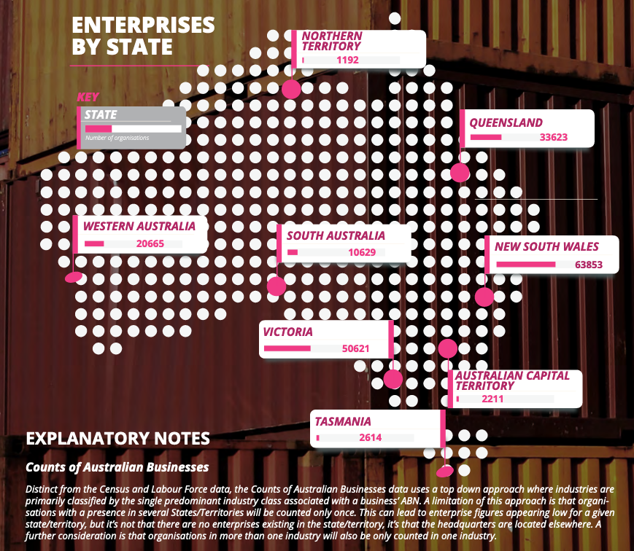

Slide 20
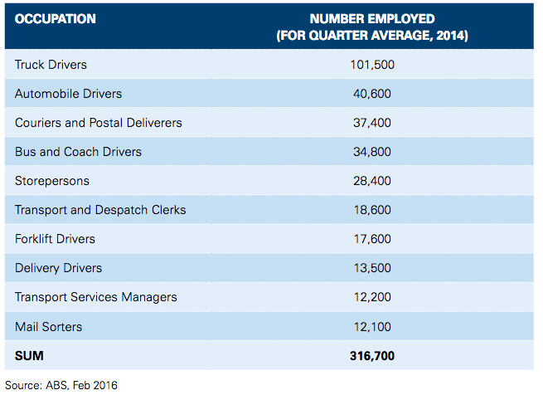
Transportation and Logistics in Australia’s
Table 1 presents the number of employees in freight sector,

Slide 21
TRANSPORT AND LOGISTICS INDUSTRY SKILL SHORTAGES
On behalf of the Transport and Logistics Industry Review Committee (IRC), Australian Industry Standards conducted an online survey for stakeholders, between 11 September 2018 and 14 January 2019.
The IRC sought feedback on the current skill shortages and the reasons for the shortages, as perceived by industry stakeholders.
TRANSPORT AND LOGISTICS SKILL SHORTAGES - Over 80 per cent of employers reported experiencing a skills shortage in the last 12 months.

Slide 22
The occupations reported as being in shortage were:
HEAVY VEHICLE DRIVERS
DRIVERS (GENERAL)
EDUCATORS,
TRAINERS AND ASSESSORS
WAREHOUSING
SUPERVISORS/MANAGERS

Slide 23
Reason for the Shortage
Employers identified the following reasons for the shortage with the most frequent response listed:
AGEING WORKFORCE / CURRENT STAFF RETIRING
UNATTRACTIVE JOB / POOR INDUSTRY IMAGE
COST/TIME TO ACHIEVE THE REQUIRED QUALIFICATION
COMPETITION FROM OTHER ORGANISATIONS
WAGES / SALARIES CONSIDERED TOO LOW

Slide 24
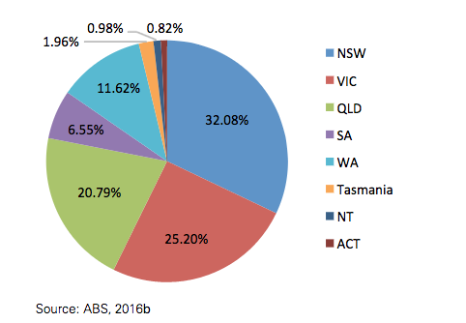
Transportation and Logistics in Australia’s
Figure 1 indicates share of each state.

Slide 25
Challenges for the industry in Australia’s
Where skills are a challenge, the key issues affecting the sector are finding the people with the right skills and qualifications needed for the roles (51%) ensuring the skills of the workforce meet industry standards (51%) and retaining the best staff and not losing them (45%).
Overall Businesses in the sector are slightly less likely than average to say they have issues keeping pace with advancing technology skills and attracting talent given they reputed to be laggers in the adoption of new technology.
Source: Dept of Education and Training and Skills Survey 2015 – 2016.

Slide 26
Main Skills Challenges experienced in the last year
Source: Dept of Education and Training and Skills Survey 2015 – 2016.

Slide 27
Key Issues Areas
ISSUES:
Decline in membership (100+ per year)
Retention of members in an ageing environment
Defence membership slashed
Low Sponsorship and Corporate Membership
STRATEGIES (how you plan to fix the problems)
CILT International Convention may create awareness of CILT Australia
International Convention Sponsors may stay on for the year
CILT Philippines may assist CILT 's Profile via perceived expansion

Slide 28
Focus Area Template
ISSUES
Decline in Membership
STRATEGIES
Focus on lifting CILT Australia's profile
Conduct more events around Australia
Social Media Presence on LinkedIn and Facebook
Podcasts and recorded interviews

Slide 29
CILT Australia's Targets from Memberships
KPI New Members from | 2020 Forecast | 2021 | 2022
Website – online applications | 140 | 150 | 170
Networking, Social, Referral | 70 | 75 | 85
Industry Events in all States | 5% | 10% | 15%

Slide 30
CILT Australia's Targets from Sponsorships
KPI | 2020 Forecast | 2021 | 2022
Develop Partner Programs of mutual benefit for CILT Australia and Partners | 3 | 4 | 5
Review Tiered Sponsorship Package for attracting new Corporate Memberships/Sponsors | 5 | 10 | 15
Identify sponsorship opportunities in support for CILT International Convention and other Events | 10+ | 13 | 14

Slide 31
CILT Australia's Targets from Education
KPI | 2020 Forecast | 2021 | 2022
Course certification –assessment and process management against Key Knowledge Areas (KKAs) | 2 | 3 | 4
CPD Management, resourced to meet the demands of CILT-A members | 1 | 1.5 | 2.0
Mentoring of WiLAT/YP and Philippine New Members | 50 | 75 | 100

Slide 32
CILT Australia's Targets from Events
Australia aims to run no loss making events.
All events aspire to be break even or return a small profit from events to assist with costs associated with providing services to our members.
We can no longer afford pay for guest speaker’s travel and accommodation unless we have received sponsorship to do so

Slide 33
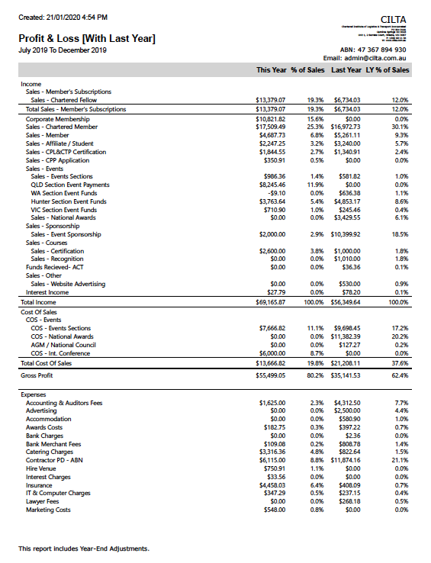
CILT Australia's Overall Profit and Loss Statement for period July -Dec 2019 - 20

Slide 34
CILT Australia's Overall Profit and Loss Statement for period July -Dec 2019 - 20

Slide 35
Conclusions
Challenges for us:
Australia has a tough couple of years ahead to try and turn the business around and turn a declining membership to an inclining one.
New revenue streams remain a challenge in regards to funding and implementation.
Website really needs updating.
Positives:
We have the International Convention 2020 that may put us back on the map.
We have the launch of the Philippines.
With the right focus leadership things could be very different in 2021.

Slide 36
Thank you
T: +44 (0) 1536 740162 E: info@ciltinternational.org Charity Registration Number: 313376

