Slide 1


Slide 2



The Chartered Institute of Logistics & Transport in Kazakhstan
CILT Kazakhstan

Slide 3
Content
Branch governance status and Council status
Membership applications and growth
Membership events & networks
Education and Training beyond the USAID project
Forums – WiLAT and Next Generation
Marketing & Communications
International Support needed

Slide 4
Branch governance status and Council status
CILT Kazakhstan

Slide 5
The Structure of the Institution
«CILT Kazakhstan»
President
Nurlan Igembayev
National Council
8 - Committee members:
1. Isingarin, Nygmatzhan Kabataevich
2. Lavrinenko, Yuri Ivanovich
3. Segal, Ilya Pavlovich
4. Kuanyshev, Bakytzhan Mukhanbetovich
5. Yudin, Nikolay Vasilyevich
6. Iskaliev, Erkhat Serikovich
7. Igembayev, Nurlan Kenjeshovich
General Director (Secretary General)
Aibek Kurmanov
Finance & Law
Education Committee
Marketing & Events
Membership Committee
1 - Yerbol Mukhaev
1 – Aray Nisupova
1 - Aibek Kurmanov
1 – Aibek Kurmanov
4 - Committee members:
1. Amangeldy Molgazhdarov
2. Berik Bulekbayev
3. Raushan Satova
4. Aibek Kurmanov
4 - Committee members:
1. Manas Userbayev
2. Maral Isteleuova
3. Yerkin Abdildin
4. Gaukhar Kenzhebayeva
Voluntary employee (16 people)
Staff employee (5 people)

Slide 6
Membership Summary
CILT Kazakhstan

Slide 7
Membership Summary
Total number of members - 54
33 members in Kazakhstan
21 members in Central Asia
150+ potential members in mailing list
200+ companies for Corporate Membership

Slide 8
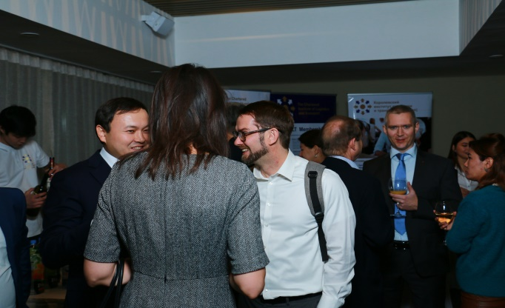
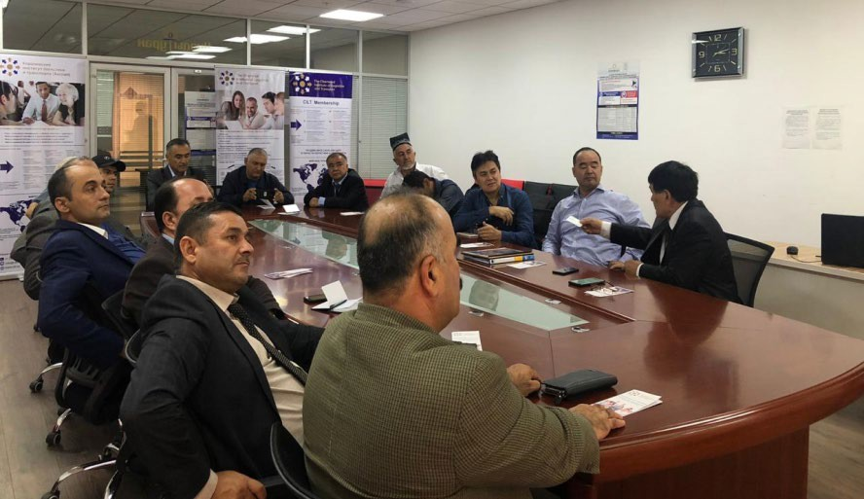
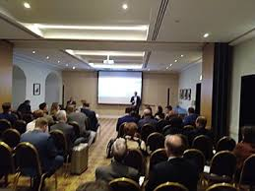
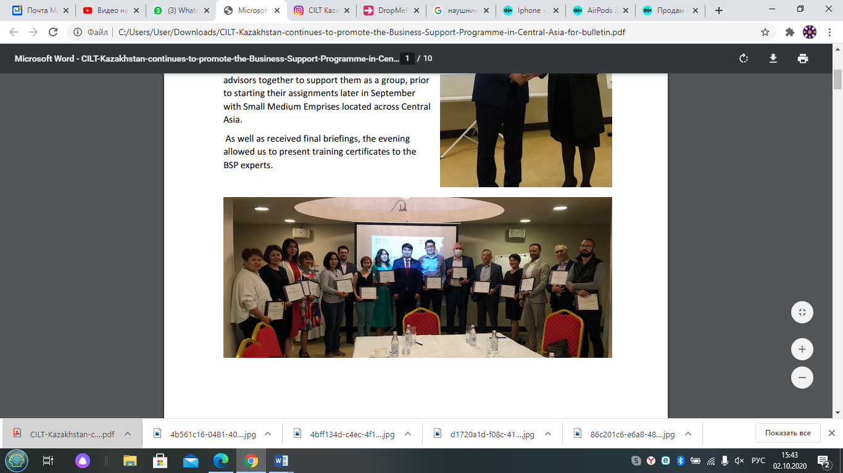



CILT Kazakhstan Membership Events

Slide 9
Membership Summary
No. | Activity | Planned – Pre-Covid | Conducted events
1 | Seminars and webinars | 51 | 24
2 | Round tables | 22 | 3
3 | Master Classes | 52 | 19
4 | Participation in business forums with presentation | 14 | 5
5 | Participation in scientific conferences | 14 | 3
6 | CILT Members’ Networking Events | 28 | 6
7 | CILT Q&A Sessions with potential members | 8 | 3
Total event activities |  | 189 | 63

Slide 10
Education and Training Activities Summary
CILT Kazakhstan

Slide 11
Education and Training Activities Summary
14 students of Level 5 from 2019 – 2020
21 new students – Level 5 Diploma in Russian language
6 MoUs with local leading universities
122 CILT short course participants

Slide 12
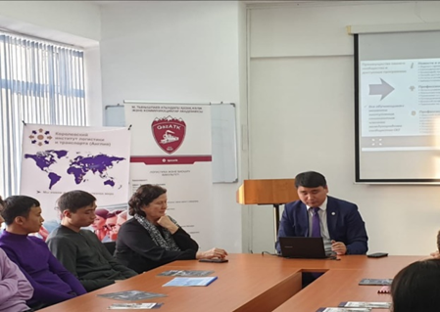
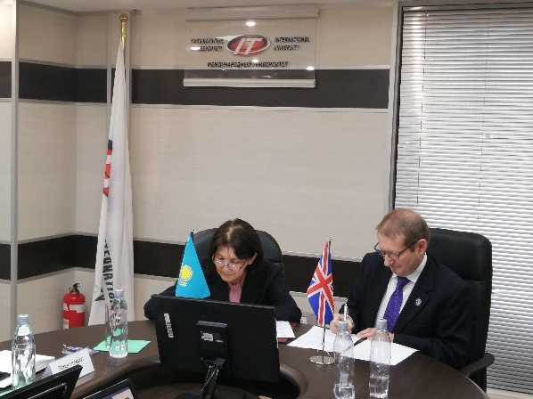
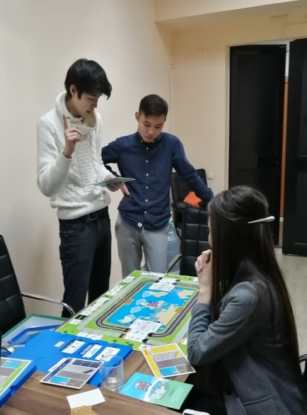
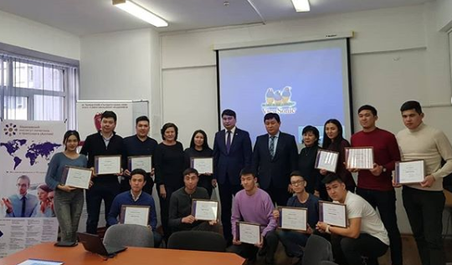
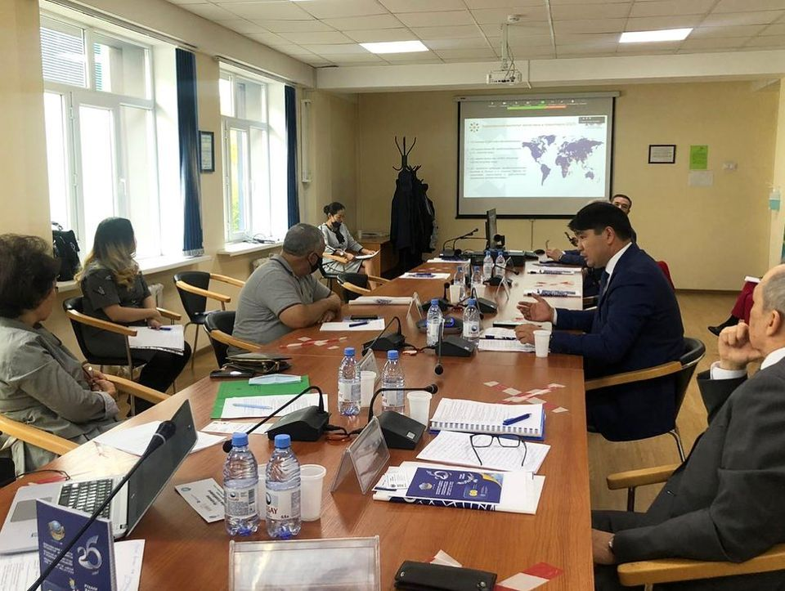
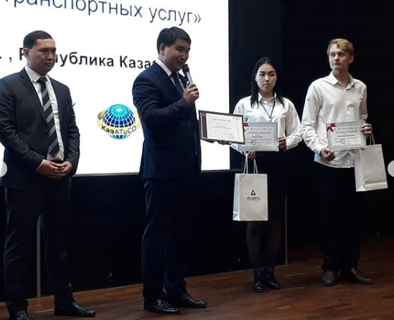
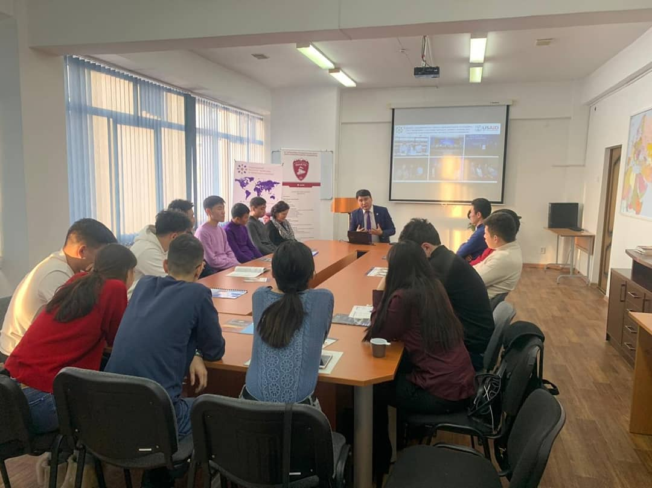
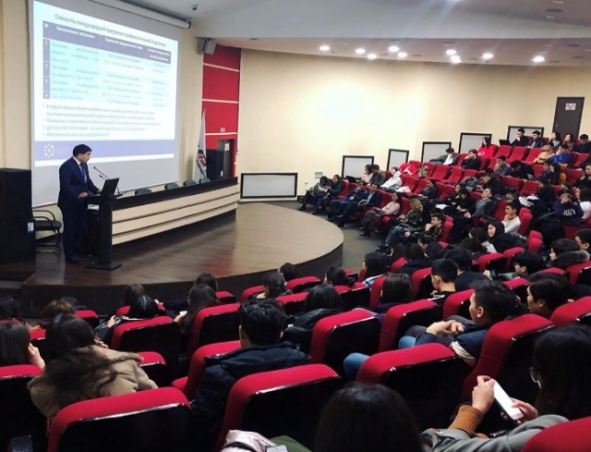
Collaborative work with Universities in Central Asia

Slide 13
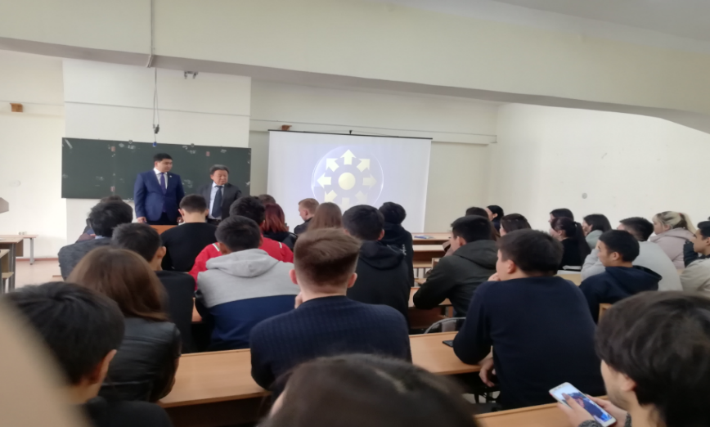
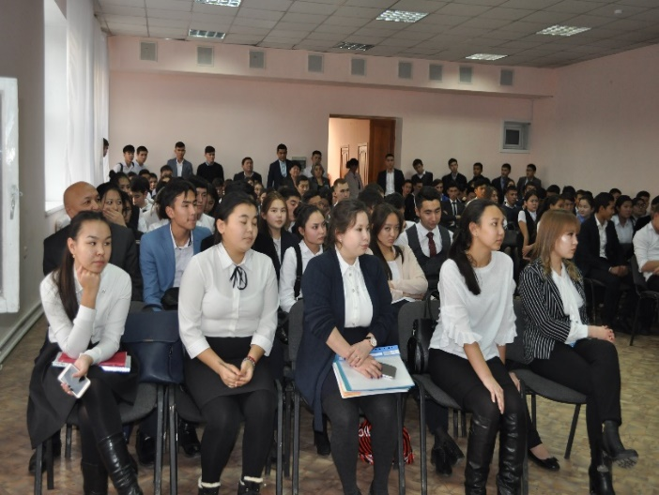
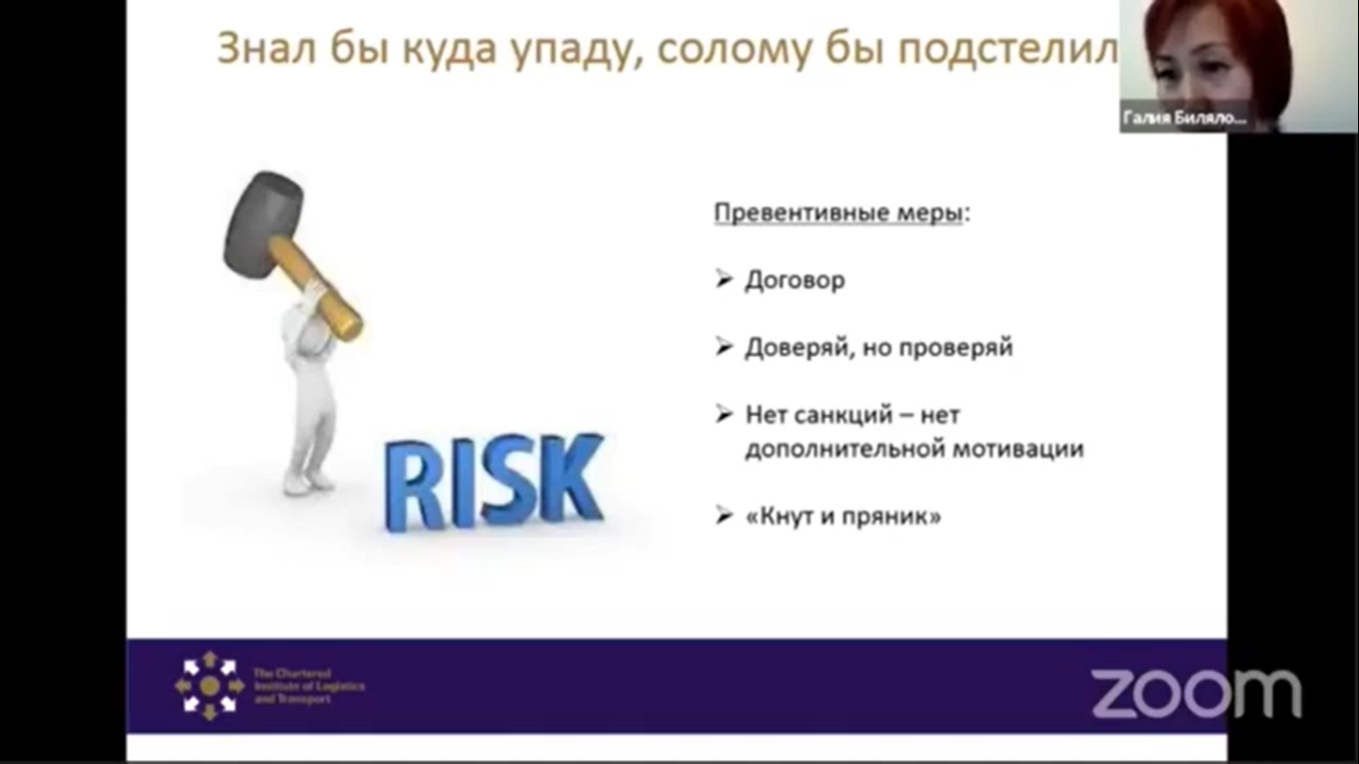
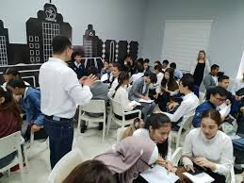
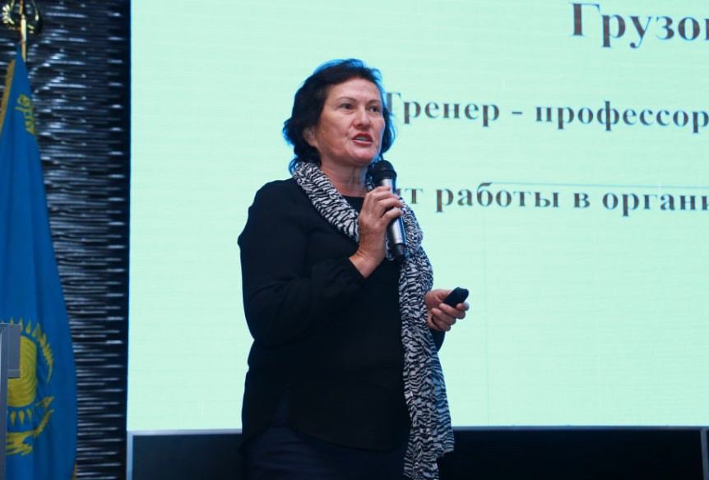
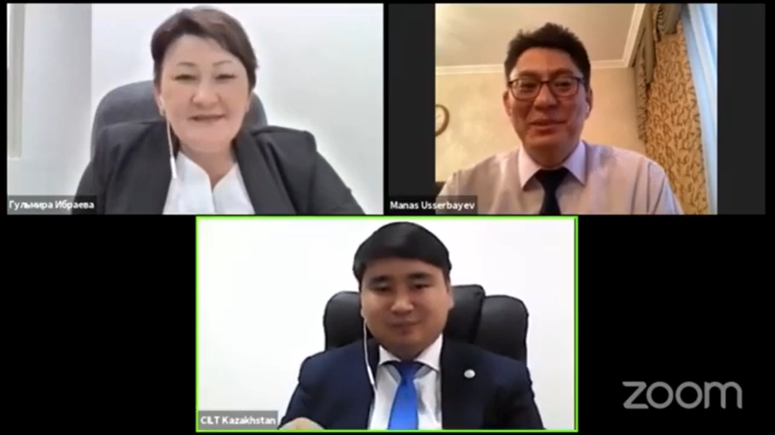
CILT Training and Online Events in Central Asia

Slide 14
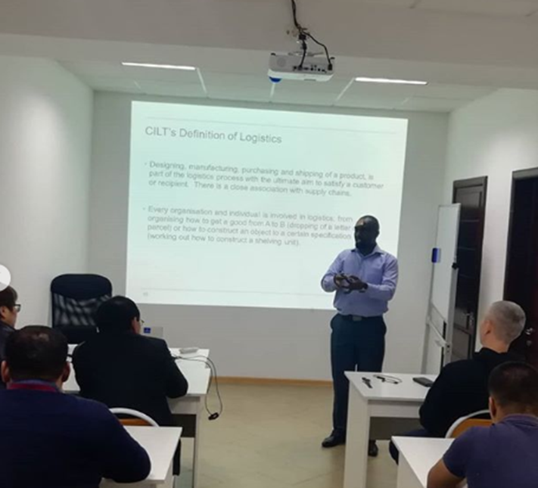
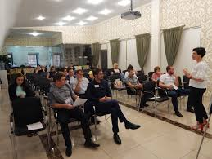
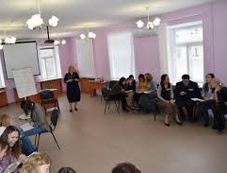
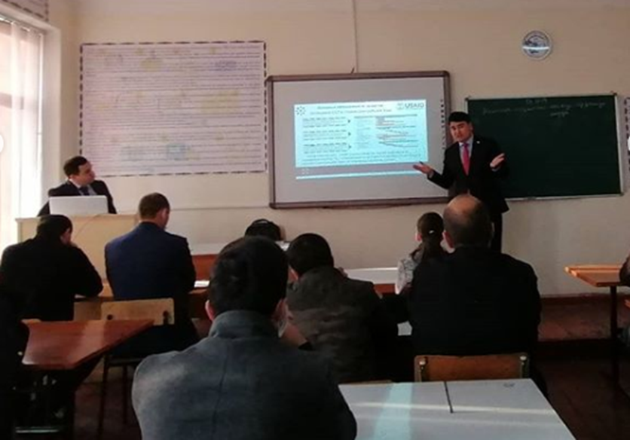
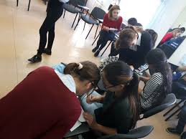
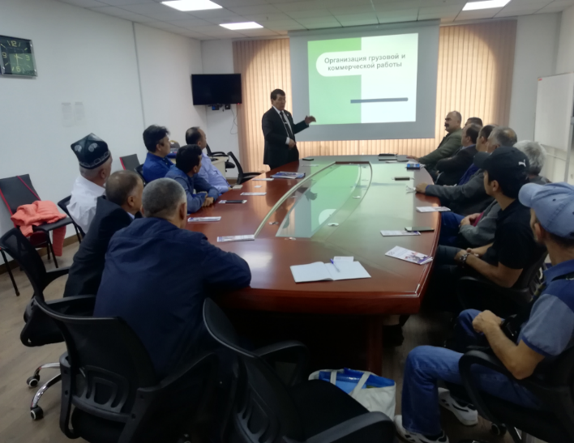
CILT Kazakhstan education process in Central Asia
(every training process includes practical training or practical video training)

Slide 15

WiLAT Central Asia
CILT Kazakhstan

Slide 16

WiLAT Central Asia Structure
CILT International council (IMC)
WiLAT Global Council
CILT Kazakhstan
WiLAT Central Asia
Chairperson
WiLAT
National Council
WiLAT Steering Committee
Council members:
1. Larisa Kislyakova (TG)
2. Nodira Mukhidova (UZ)
3. Daria Kodzhekulova (KG)
4. Sahra Amanova (TM)
5. Elmira Darusheva (KZ)
6. Marina Kuznechevskaya (KZ)
Marina Kuznechevskaya
Vice-Chairperson
Aizhan Beiseeva
Marketing & Events
manager
Marketing & Events
manager
Membership Committee manager
Membership Committee manager
Office manager
Office manager
Arai Maratkyzy
Arai Maratkyzy

Slide 17
WiLAT Central Asia Membership Services
№ | Activities & Events | periodicity
1 | WiLAT Global anniversary celebration conference | every year
2 | WiLAT Central Asia anniversary celebration conference | every year
3 | Seminars on topical issues of the industry | every month
4 | Master classes and Mentoring Sessions | every month
5 | Networking Events | every month
6 | Round tables with local professionals | every two months
7 | CILT Kazakhstan National Conference | every two year
8 | CILT International Annual Convention | every year
9 | Additional Informational magazines and news bulletins | every weeks
10 | Mentoring Program events | every two weeks
11 | Joint Collaborative events among the women’s groups to create synergy with other organizations. | every two months
10 | Chat sessions or life enrichment seminars that would give advice and support to the women in the industry | every two weeks
 |  | 100 events

Slide 18
WiLAT Central Asia Events Calendar
No. | Activities & Events | Date
1 | WiLAT Central Asia preparatory phase | Oct 2020 – Aug 2021
 | Central Asian Council | Oct 2020
 | Marketing campaign (website, direct marketing, social media, events, WiLAT CA newsletters and bulletins) | Ongoing
 | Documentation (Application Form, Guidance, etc.) First batch of WiLAT Central Asia members | Oct 2020 Oct 2020 – Dec 2020
 | Joint Collaborative events among the women’s groups to create synergy with other organizations | Starting from Nov 2020
 | Seminars and webinars on topical issues of the industry and Master Classes | Starting from Nov 2020
 | WiLAT Networking Events | Starting from Dec 2020
 | Mentoring Program | Starting from Mar 2021
 | Chat sessions or life enrichment seminars that would give advice and support to the women in the industry | Starting from Mar 2021
2 | CILT Kazakhstan National Conference and WiLAT Central Asia celebration conference and official launching ceremony | Sept 2021
 | Full range of Membership Services for WiLAT members (In addition to CILT services) | Starting from Sept 2021

Slide 19
Marketing Campaign
No. | Activities & Events | Date
1 | Marketing Phase I – Initial Launch | Oct 2020 – Aug 2021
 | WiLAT Central Asia social media marketing (Instagram, Facebook, etc.) | Launch in Oct 2020
 | Website | Launch in Nov 2020
 | WiLAT Features (Pin, Business Cards, Banners) | Nov 2020
2 | Marketing Phase 2 – Events | Starting from Nov 2020
 | Webinars on relevant topics / Master classes from industry leading women (once a month) | Starting from Nov 2020
 | Seminars and webinars on topical issues of the industry and Master Classes | Starting from Nov 2020
 | WiLAT Networking Events / Joint Collaborative events among the women’s groups to create synergy with other organizations | Starting from Dec 2020
 | Newsletters and Bulletins | Starting from Dec 2020
3 | Marketing Phase 3 - Support | Starting from Feb- Mar 2021
 | Mentoring Program | Feb-Mar 2021
 | Chat sessions or life enrichment seminars that would give advice and support to the women in the industry | Mar 2021
 | Website Publications – Useful information for women | Feb 2021

Slide 20
WiLAT Central Asia launching
WiLAT Central Asia annual minimum operating cost for the first starting year is - 142 880 USD which covers 1000 memberships:
  Chartered Fellow (FCILT) – 50 women
  Chartered Member (CMILT) – 250 women
  Member (MILT) - 700 women
This include benefits:
  Access to all CILT international, WiLAT Global and Local events and benefits;
  Exclusive WiLAT local events including:
    Networking events
    Master classes from local leading business women
    Mentoring program
  CILT International and CILT Kazakhstan membership

Slide 21
WiLAT Central Asia implementation
Sponsorship of 150 000$ is required for the launching WiLAT Forum in Central Asia to encourage empowerment and promote the status of women in Supply Chain, Logistics and Transport
WiLAT Central Asia development support from CILT International and WiLAT Global
Announcement & Launching WiLAT Forum in Central Asia
WiLAT Global ongoing support on Mentoring & Couching
WiLAT Central Asia ongoing activities to encourage empowerment and promote the status of
women in Supply Chain, Logistics and Transport in Central Asia

Slide 22





WiLAT Central Asia launching
Potential partners and sponsors:
Government of the Republic of Kazakhstan
European Bank for Reconstruction and Development (EBRD)
USAID
DAI
Asian Development Bank (ADB)
Deutsche Gesellschaft für Internationale Zusammenarbeit (GIZ)

Slide 23
Next Generation in Central Asia
CILT Kazakhstan

Slide 24
Next Generation in Central Asia
Enhanced networking and support opportunities for members in the early stages of their career.
Development of Next Generation in Central Asia concept and implementation of the Next Generation global strategy in the region through:
  Collaboration with universities, institutions, and local forums (Kazlogistics, government supported programs, etc.)
Tasks: Set-up, promotional launch, membership/generation and provision of webinar and other learning/development opportunities for this group
Outputs:
Launch of Next Generation through virtual event
Securing of 20 members by end January 2021, 50 by end May 2021, 70 by end August 2021
Next Generation social media and web pages
Next Generation events powered by young professionals running their own series of online and face to face events (Covid-19 permitting) – 10 events by end August 2021

Slide 25
Marketing & Communications
CILT Kazakhstan

Slide 26
Marketing work summary - 2020
Build the capacity of CILT Kazakhstan to service and support the Central Asian region
Key marketing objectives:
Build recognition of CILT-KZ as the leading professional body in the region on logistics, transport and supply chains management through marketing campaign, regular conferences and events
Establish CILT Kazakhstan as a regional hub that administers the ongoing development and embedding of knowledge and standards, ensuring quality and consistency
Scope of Marketing work under COVID-19:
Prioritization of online events and webinars to support our members and businesses facing economic challenges and planning for resilience and recovery;
International bulletins to inform people and organizations of global best practice responses to the current crisis;
Local newsletters and relevant important information posted in social media platforms.

Slide 27
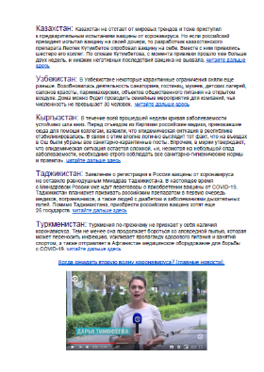
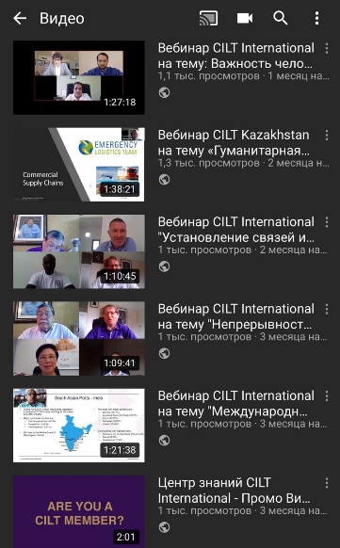
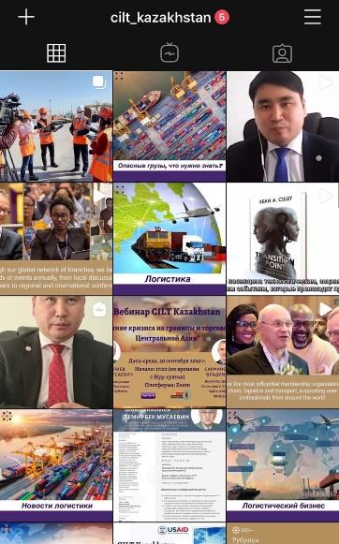
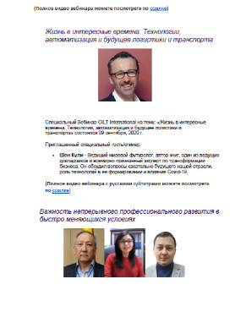
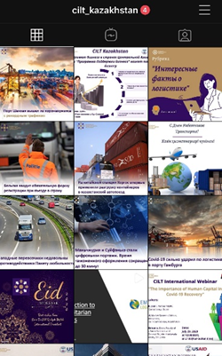
Marketing Illustrations

Slide 28
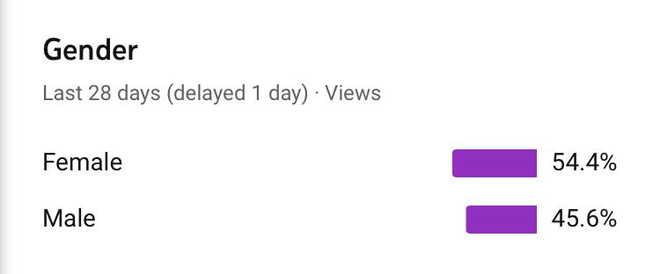
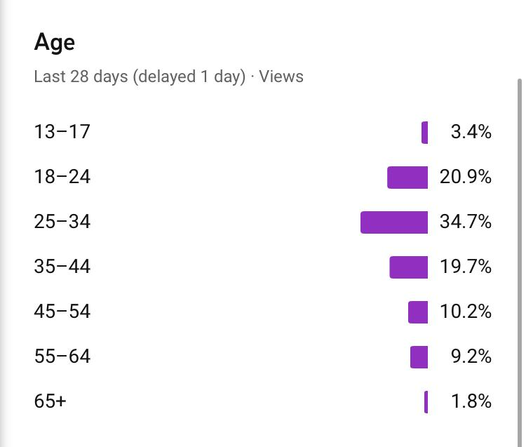
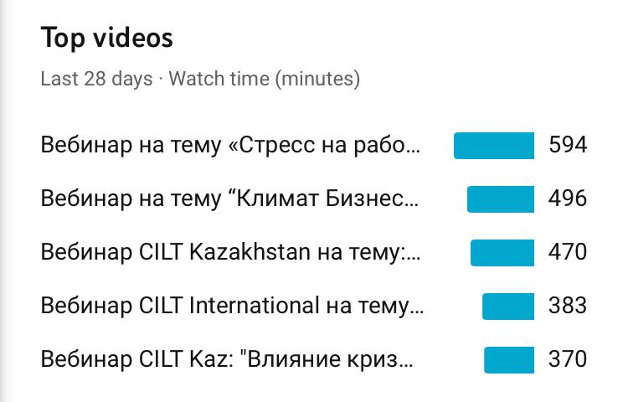
YouTube Analytics
Since starting the business resilience support program and online webinar learning in May 2020 the number of views on YouTube has reached over 24,000 views, an average of 147 views per day.

Slide 29
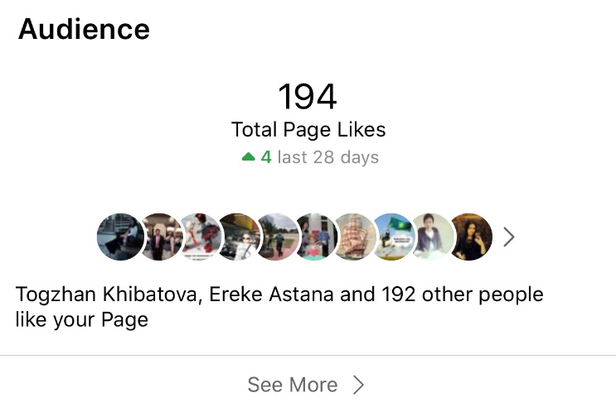
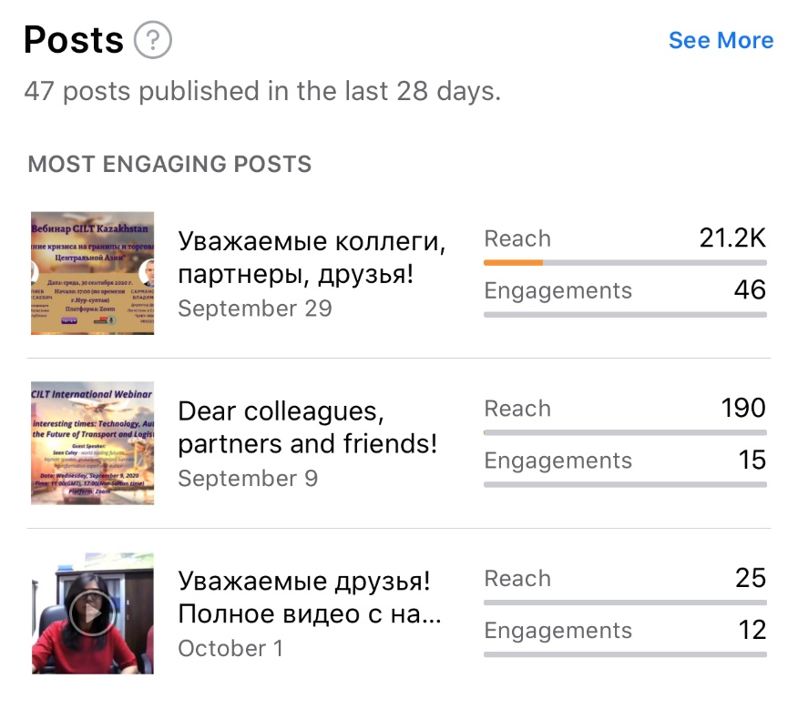
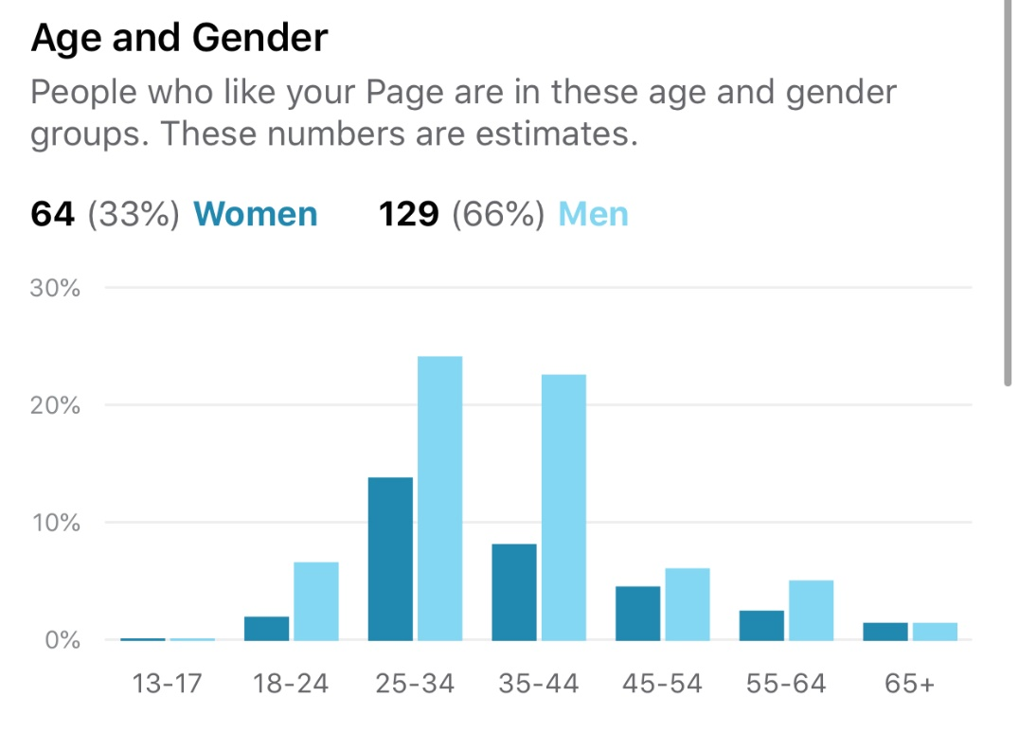
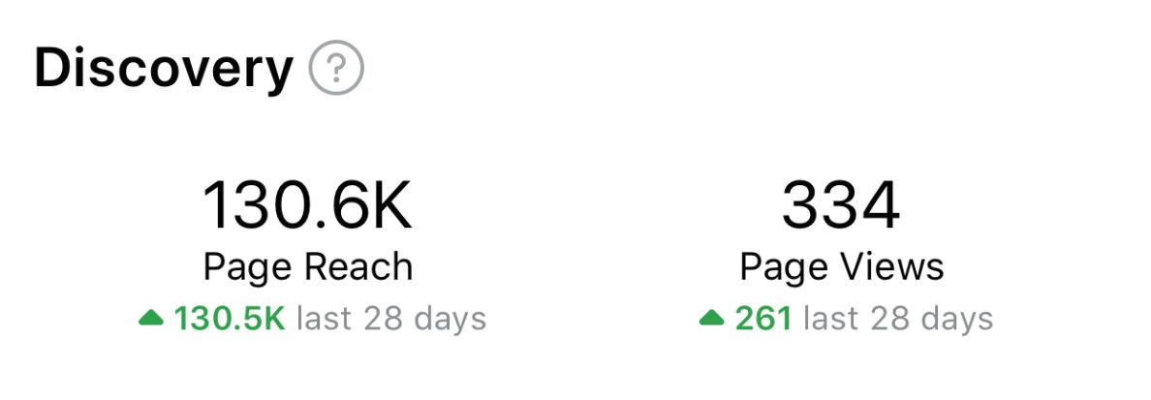
Facebook Analytics

Slide 30
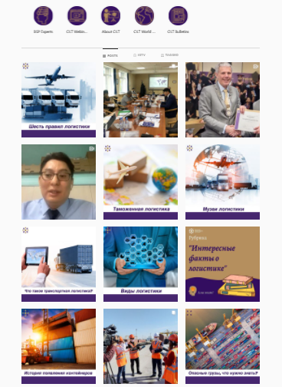
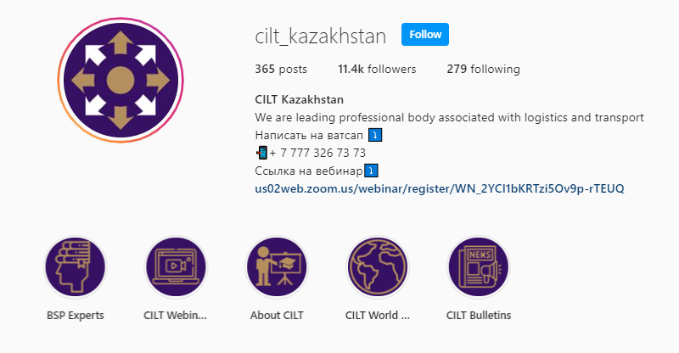
Instagram – the most popular social media platform in Central Asia
365 post, 11 400 followers in Instagram

Slide 31






Forward Strategy and Development
CILT Kazakhstan

Slide 32

2020 Forward development strategy of human recourses for transport and logistics of Central Asia
Completed objectives
Setting up CILT Kazakhstan as a training and professional development hub for
Central Asia
Ongoing work:
Implement CILT standards and qualifications of the Institute to guarantee of
knowledge and professionalism in the Central Asian region
Further industry surveys and engagement of training gaps and priorities in the each
region
Further implementation of the BSP program on commercial basis:
  Identifying fixed rates for companies to pay
  Including the program benefits to the Corporate Membership Program
  Further developing the pool of experts/advisors
  Building a sustainable model
Enhance level of competence within company workforces as a direct result of the consultancy and technical monitoring programmes – complementing traditional training
Ensure that workforce are upskilled and developed so they are more competent in delivering logistics and supply chain techniques, leading to better customer service, increased productivity and potentially growth in turnover and profitability.

Slide 33
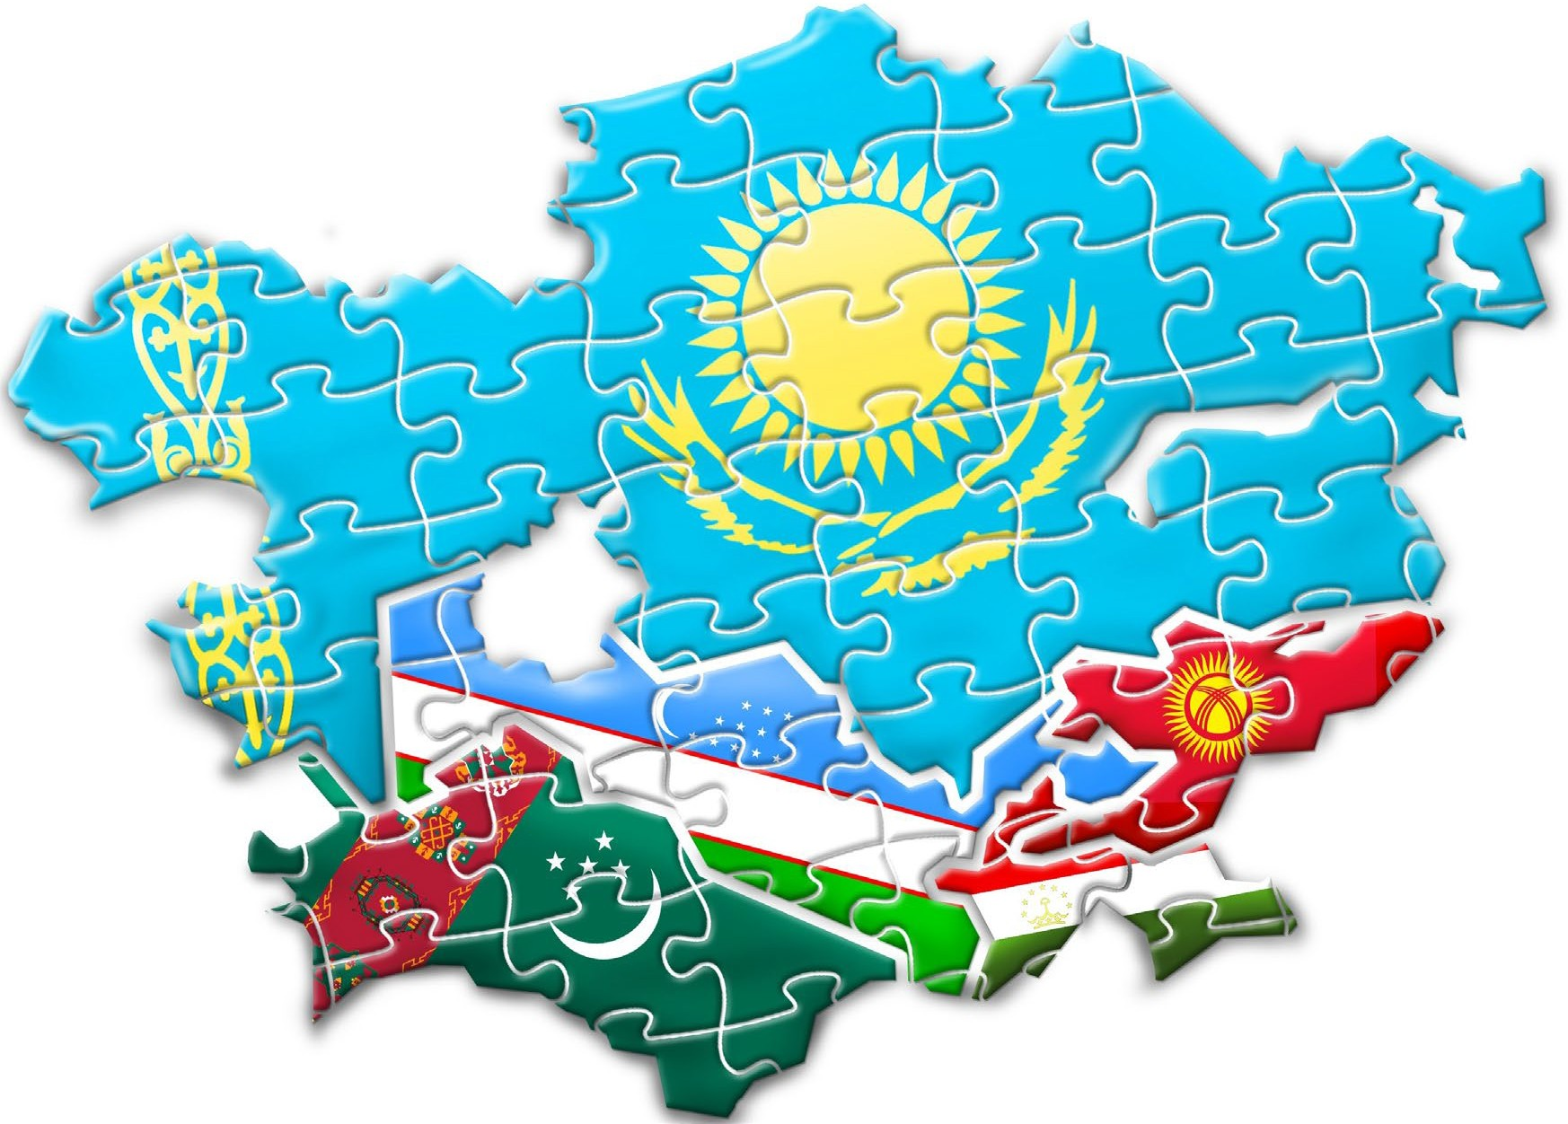

Proposed Strategy of CILT in Central Asia
Direction 1: Building the capacity of CILT
Kazakhstan to service and support Central Asia
Direction 2: A sustainable and scalable
professional development model to build
capability and develop the trainer pool in Central Asia
Direction 3: Training and Consultancy Services to businesses (primarily SME’s) improving capability, efficiency and effectiveness

Slide 34
International Support
CILT Kazakhstan

Slide 35
International Support needed
Further management support from International Education Strategy and Business Development Lead
Marketing support
Updated Education materials
Membership Legal services - best practice form CILT UK
Additional development of services - development of new products and services

Slide 36

Thank You!
Nurlan Igembayev
President of CILT Kazakhstan
E-mail: igembaev@gmail.com
Tel: +7 701 801 7744

