Slide 1
With grateful thanks to our event sponsor, MTR

Slide 3

We are stronger together.
WE ARE CILT
Celebrating 100 years supporting
transport and logistics professionals

Slide 5

I’m connected.
I’m recognised.
I AM CILT
Celebrating 100 years supporting
transport and logistics professionals

Slide 7

We have the knowledge.
We have the support.
WE ARE CILT
Celebrating 100 years supporting
transport and logistics professionals

Slide 9

Today I am a student.
Tomorrow I will change the world.
I AM CILT
Celebrating 100 years supporting
transport and logistics professionals

Slide 11

I’m a leader.
I share my experience.
I AM CILT
Celebrating 100 years supporting
transport and logistics professionals

Slide 13

I learn, I adapt,
I succeed.
I AM CILT
Celebrating 100 years supporting
transport and logistics professionals

Slide 15

We believe in equality. We are
working towards our shared future.
WE ARE CILT
Celebrating 100 years supporting
transport and logistics professionals

Slide 17

I’m internationally recognised.
My qualifications match my ambition.
I AM CILT
Celebrating 100 years supporting
transport and logistics professionals

Slide 19

I work across borders.
I bring people together.
I AM CILT
Celebrating 100 years supporting
transport and logistics professionals

Slide 21

I represent the highest standards in education and best practice.
I AM CILT
Celebrating 100 years supporting
transport and logistics professionals

Slide 23

I don’t just dream,
I create my own future.
I AM CILT
Celebrating 100 years supporting
transport and logistics professionals

Slide 25

I can access a network of experience.
I have the knowledge I need to succeed.
I AM CILT
Celebrating 100 years supporting
transport and logistics professionals

Slide 27

I am qualified.
I am capable.
I AM CILT
Celebrating 100 years supporting
transport and logistics professionals

Slide 29

We are part of a global network.
We are stronger together.
WE ARE CILT
Celebrating 100 years supporting
transport and logistics professionals

Slide 31
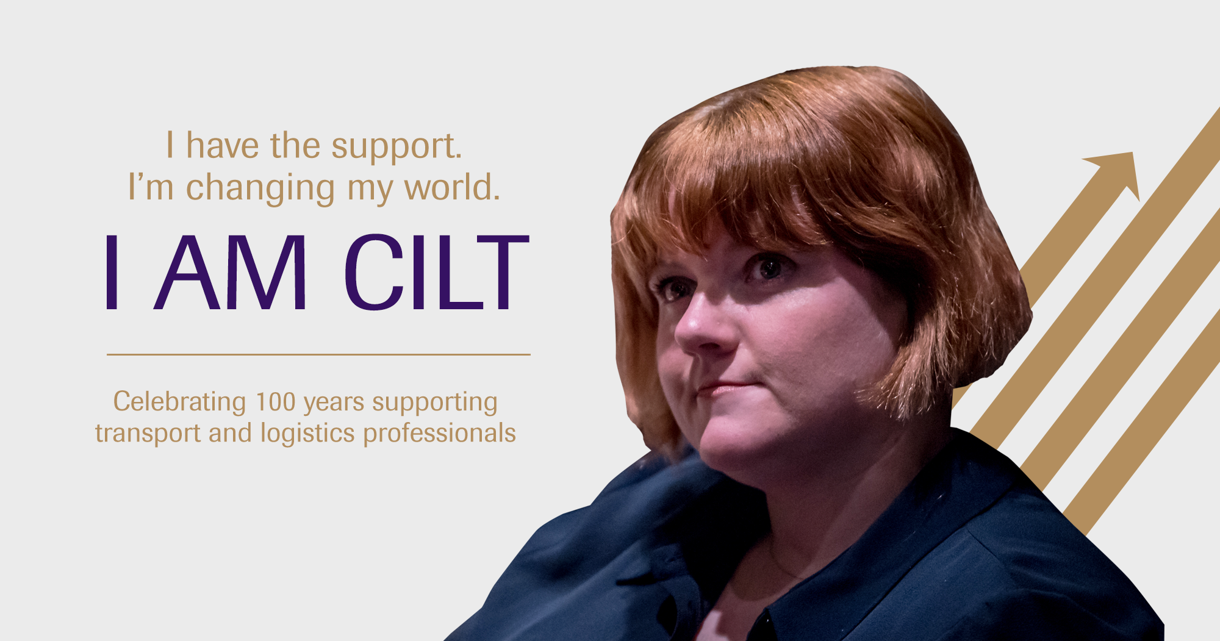
I have the support.
I’m changing my world.
I AM CILT
Celebrating 100 years supporting
transport and logistics professionals

Slide 33

I’m an expert in my field.
My qualifications are internationally recognised.
I AM CILT
Celebrating 100 years supporting
transport and logistics professionals

