Slide 1
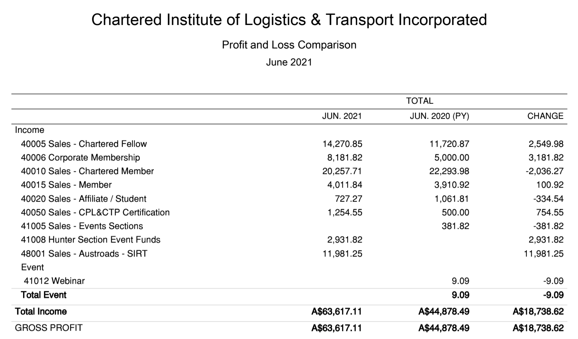
CILT Australia Overall Profit and Loss for 2020 - 21
This needs to be costs income per year with the latest year as current.

Slide 2
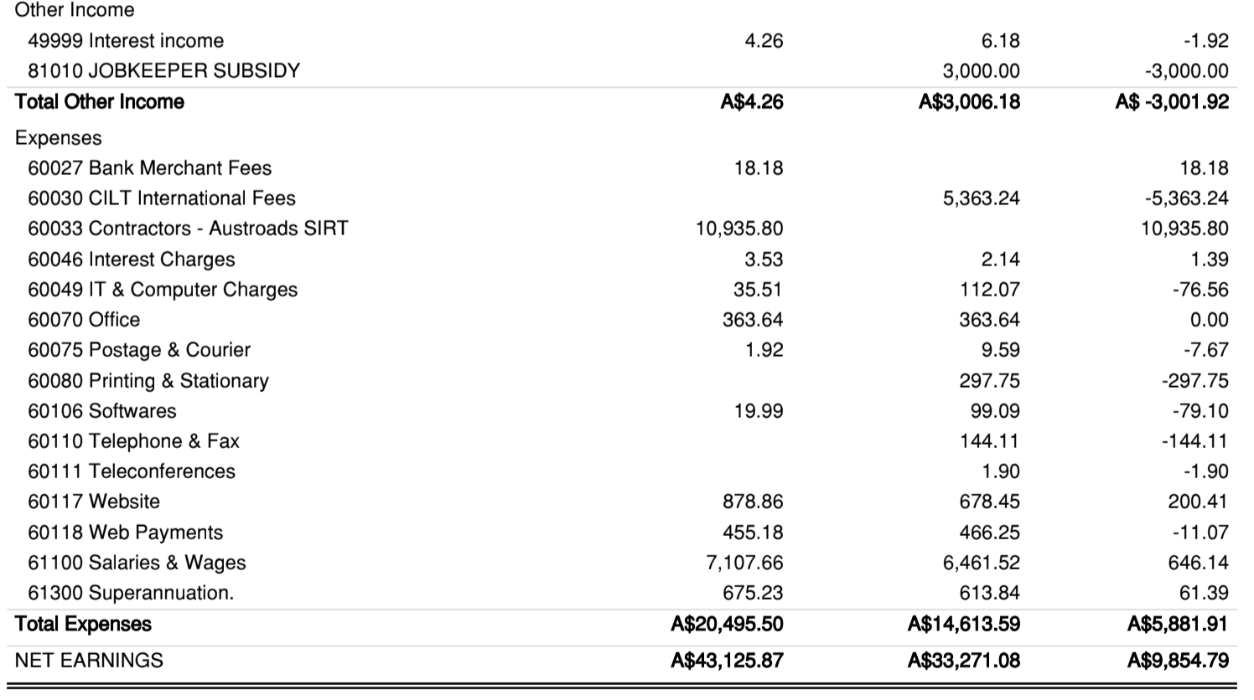
CILT Australia Overall Profit and Loss for 2020 - 21
Please refer Financial Statements prepared by the auditor in this link

Slide 3
CILT Australia Overall Profit and Loss for 2022 - 25
Projections of how the income will change over the period 2022 – 25
Income will change should Australia be successful in it drive for 5% increase year on year for membership
Govt Subsidies available in 2020/21 period were to support businesses through COVID. These subsidies were a one off.
Tax incentives also provided by Govt to business for the 2021/21 were also a one off.
Events income will increase as a result of the International convention scheduled for October 2022
It is also hoped that Sponsorships increase as a result of the 2022 International Conference

